Slide 1
Digging for Information
CS-695 Host Forensics
Georgios Portokalidis

Slide 2

Learn by Example
Something is amiss with Barney
  Don’t worry Barney is a computer
  ssh daemon found listening on port 33332
The administrator’s rushed to the rescue
  Backed up all directories with suspicious files
Three days later, the security staff had a look

Slide 3
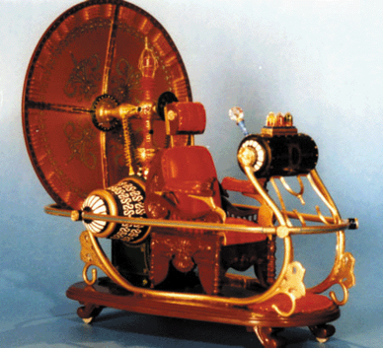

A Time Machine Would be Useful

Slide 4
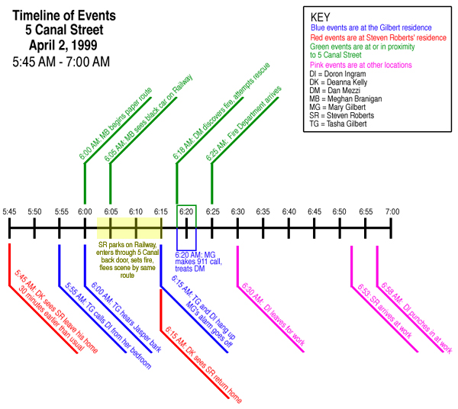
What We Really Want is a Timeline
Knowing when something happened is important!

Slide 5
Timeline Events
Installation of a new program
A user logging in
Creation of a file
A listening socket
Modified data

Slide 6
File MACtimes
File meta-data that refer to
  Last time a file was Modified
  Last time a file was Accessed
  Time when file was Created
On Unix systems file attributes: mtime, atime, ctime
Important note! These attributes only save the last time

Slide 7
Obtaining MACtimes
Can be as easy as running ls
Use mactime from sleuthkit
  http://www.sleuthkit.org/
Write your own program to do it
  Use lstat() system call

Slide 8
Back to Barney
Jul 19 2001
time size MAC permissions owner file name
---- ---- --- ---------- ----- ---------
16:47:47 655360 m.. -rw-r--r-- root /usr/man/.s/sshdlinux.tar
16:48:13 655360 ..c -rw-r--r-- root /usr/man/.s/sshdlinux.tar
16:48:16 395 ..c -rwxrw-r-- 2002 /usr/man/.s/ssh.sh
880 ..c -rw-r--r-- 2002 /usr/man/.s/ssh_config
537 ..c -rw------- 2002 /usr/man/.s/ssh_host_key
341 ..c -rw-r--r-- 2002 /usr/man/.s/ssh_host_key.pub
16:48:20 1024 m.c drwxr-xr-x root /usr/man/.s
16:51:31 1024 m.c drwxr-xr-x root /home
1422 m.c -rw-r--r-- sue /home/sue/.Xdefaults
24 m.c -rw-r--r-- sue /home/sue/.bash_logout
230 m.c -rw-r--r-- sue /home/sue/.bash_profile
124 m.c -rw-r--r-- sue /home/sue/.bashrc
16:57:57 1024 m.c drwx------ sue /home/sue
9 m.c -rw------- sue /home/sue/.bash_history
Helpful administrator!
Beware when accessing data
Notes:
We wont find any useful access time

Slide 9
Things to Keep in Mind
Must preserve data that spoils first
  Remember the order of volatility
Make bit-per-bit copy, don’t copy, backup!
  Work on a read-only copy
Be careful when accessing files and directories
  Opening a directory for reading alters atime
Beware of GUI-based utilities
Time can be forged!
  Find out what kind of intruder you are investigating

Slide 10
Bread Crumbs
How did the ssh server get there?
Look at the network
  Storing raw data is expensive
  Even summarized can be expensive
    E.g., Argus and Netflow (Audit Record Generation and Utilization System)
  Look for TCP flows
Jul 19 2001
start end proto source destination
==============================================================
16:30:47-16:47:16 tcp 10.0.0.1.1023 192.168.0.1.33332

Slide 11
What Else Happened Around That Time?
FTP ports
Jul 19 2001
16:28:34-16:29:36 tcp 192.168.0.1.1466 10.0.1.1.21
16:29:30-16:29:36 tcp 10.0.1.1.20 192.168.0.1.1467
16:30:47-16:47:16 tcp 10.0.0.1.1023 192.168.0.1.33332
Barney
Tar file was created at 16:48:13
FTP connection occurred at 16:29:30
Clock skew between Netflow and Barney

Slide 12
The Plot Thickens
More connections from 10.0.0.1 around that time
Jul 19 2001
16:25:32 tcp 10.0.0.1.44445 192.168.1.1.110
16:25:49 tcp 10.0.0.1.44445 192.168.0.1.110
16:25:53-16:30:26 tcp 10.0.0.1.44445 192.168.0.1.21
Port number
looks
suspicious
DNS port
Aug 21-22 2000
23:59:55-00:29:48 tcp 10.0.3.1.1882 192.168.0.1.53
Aug 22 2000
00:08:32-00:09:04 tcp 192.168.0.1.1027 10.0.2.1.21
00:08:42-00:09:04 tcp 10.0.2.1.20 192.168.0.1.1028
00:11:08-00:13:26 tcp 192.168.0.1.1029 10.0.2.1.21
00:12:07-00:12:13 tcp 10.0.2.1.20 192.168.0.1.1030
00:13:38-00:13:35 tcp 10.0.2.1.44445 192.168.0.1.21
Notes:
Actually these are not connections but scans.
When 192.168.0.1 was investigated, and more evidence found. What could that evidence be? Other files, a bug advisory for bind, etc.
When you know something is wrong, it’s easier to find evidence. Also, why the network logs did not give away the attack earlier.

Slide 13
The Timeline of the Attack
Network data can be more trustworthy
Can go easily undetected
Timeline 1
Install sshd
Initial attack
Discovery
7/19/2001
8/23/2001
8/20/2001
Further exploitation
Start
investigation
Install sshd
Timeline 2

Slide 14
Evidence and Time Elsewhere
Locally (easy to forge)
  Log files
  FS Journal
Other hosts
  DNS

Slide 15
who-active user snapshot
Provides
  Username
  Terminal or windows
  Start of session
  Origin if remote
Files: /var/run/utmp, /var/log/wtmp
  Better consult the man page
gportoka pts/0 2013-01-22 03:06 (cpe-10-1-1-2.nyc.res.rr.com)

Slide 16
last – Past Login Activity
Provide
  Username
  Terminal or window
  Session start/end/duration
  Origin if remote
Files: /var/log/wtmp, /var/log/btmp
Now includes also bad login attempts

Slide 17
lastlog – Time of Last Login
Provides
  One entry per user
  Terminal port
  Time of login
  Origin if remote
Files: /var/log/lastlog
gportoka pts/0 cpe-10-1-1-1 Tue Jan 22 03:06:32 -0500 2013

Slide 18
Other Logs
Syslog: Linux system logging facilities → Lots of information
The kernel ring buffer (dmesg)
Jan 21 22:58:23 barney sshd[4106]: error: Could not get shadow information for NOUSER
Jan 21 22:59:50 barney sshd[4209]: fatal: Read from socket failed: Connection reset by peer [preauth]
24280299:624280990 (repaired)
[2147893.249124] TCP: Peer 10.0.0.1:29424/50325 unexpectedly shrunk window 6
25486676:625489368 (repaired)
[2481628.216678] sshd[16837]: segfault at 8 ip 083c1636 sp bfdf66e0 error 4 in sshd[8048000+b88000]

Slide 19



Journaling File Systems
Update
Actual write
User
Journal
Hard drive
Journals allow for easy recovery
You may be able to recover the last updates
Useful programs for ext2/3 file systems
  Tune2fs
  debugfs

Slide 20
DNS and Time
Usually run by bind
DNS’s data reside is in memory
  You can dump recent queries in a file (rndc or SIGINT signal)
165.49.240.10.in-addr.arpa. 479 PTR rainbow.fish.com.
209.in-addr.arpa. 86204 NS chill.example.com.
rasta.example.com. 10658 A 192.168.133.11
al.example.com. 86298 NS ns.lds.al.example.com.
4.21.16.10.in-addr.arpa. 86285 PTR mail.example.com.
TTL

Slide 21
DNS and Time (2)
Obtain the original TTL of a DNS entry
You’ll probably have to write your own code
  AWK, Perl, Python
linux # host -t soa -v porcupine.org
porcupine.org 10800 IN SOA spike.porcupine.org wietse.porcupine.org(
2004071501 ;serial (version)
43200 ;refresh period
3600 ;retry refresh this often
1209600 ;expiration period
86400 ;minimum TTL
)
Time
Initial DNS
response
Bind’s cache
Expiration date

Slide 22
Some Lessons About Time
Creating a timeline of events can be extremely useful
However:
  Time can be forged
  … lost (clock skews)
  and hard to interpret

Slide 23
File System Basics

Slide 24
Bad News, Good News
There are more file systems than operating systems
We are only going to talk about UNIX file systems
  The principles are the same
  The gory details frequently different

Slide 25
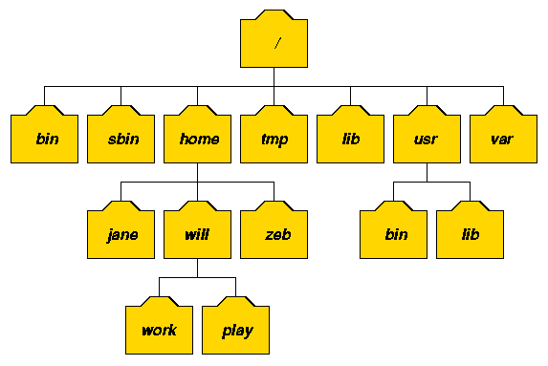
UNIX File Systems
Hierarchical
Composed by different partitions/drives
/dev/sda1
/dev/sdb
/dev/sda2

Slide 26
A Hidden Tile
# df
Filesystem 1k-blocks Used Available Use% Mounted on
/dev/sda1 1008872 576128 381496 60% /
/dev/sda5 16580968 15136744 601936 96% /home
# ls /research
foo
# cat /research/foo
hello, world
# mount /dev/sdb1 /research
# ls /research
lost+found src tmp
# cat /research/foo
cat: /research/foo: No such file or directory

Slide 27
Useful Commands
mount and umount
  Make a partition part of the tree (and remove)
fuser and lsof
  Identify who is using a file(s)
fdisk
  Format or access the partition table
dmesg
  Access the kernel ring buffer

Slide 28
UNIX Files
Files are stored in directories
Filenames can contain any character besides ‘/’
  Maximum length depends on the system
  File system dependant
  Can be a source of trouble
$ touch '/tmp/foo
/etc/passwd’
# find /tmp -mtime +1 | xargs rm -f

Slide 29
UNIX Pathnames
‘/’ character is used to construct a path in the file system
Maximum length also limited
Also source of forensic trouble
  This path has 1028 characters
  Conflicts with system call argument limits
    Instead use …at() family of system calls
/111 ... 111/222 ... 222/333 ... 333/444 ... 444/foo

Slide 30
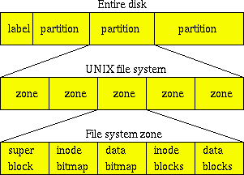
UNIX File System Layout
Disk geometry
Or block group
FS information

Slide 31
UNIX File Types
Regular
Directories
Symbolic links
  Different from hard links
Named pipes
UNIX sockets
Device files
  Real or virtual devices

Slide 32
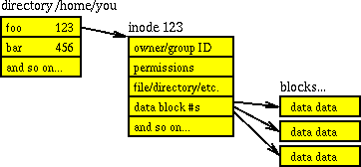
Under The Hood
Each file in a directory is described by an inode
Each directory contains a list of name⬄inode numbers associations

Slide 33
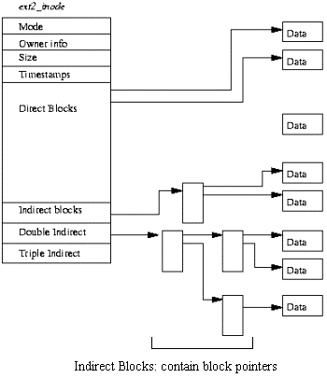
inode Contents
Ownership
Permissions
File type
Hard link count
File size
Time stamps
Data block addresses
Extended attributes?
Useful sleuthkit tools: ils, icat, fls

Slide 34
Bypassing The File System
# mount /dev/sdb1 /research
# ls -1ia /research
2 .
2 ..
11 lost+found
32449 tmp
# fls -ap /dev/sda1 32065
-/d 96193: .
-/d 2: ..
-/r 96741: foo
# cat /research/foo
cat: /research/foo: No such file or directory
# icat /dev/sda1 96741
hello, world

Slide 35
Buffering
solaris# df
Filesystem kbytes used avail capacity Mounted on
/dev/dsk/c0t0d0s7 2902015 1427898 1416077 51% /export/home
solaris# echo hello, world > test-file
solaris# ls -i test-file
119469 test-file
solaris# cat test-file
hello, world
solaris# icat /dev/dsk/c0t0d0s7 119469
solaris# icat /dev/rdsk/c0t0d0s7 119469
hello, world

Slide 36
Sparse Files
Files with holes
#!/usr/local/bin/perl
open(F1, ">F1") or die "can't open F1\n";
print F1 "Text before test";
seek(F1, 100000, 2); # boldly seek where no data has gone before
print F1 "Text after test”;
close(F1);
linux $ hexdump -c F1
0000000 T e x t b e f o r e t e s t
0000010 \0 \0 \0 \0 \0 \0 \0 \0 \0 \0 \0 \0 \0 \0 \0 \0
*
00186b0 T e x t a f t e r t e s t
00186bf
Notes:
Over the file system it’s impossible to tell if nulls are read because of a hole or not

Slide 37
Revisiting Time
Accessing RAW file system inodes does not modify timestamps
  Risk of losing you data
  Intruders don’t necessarily care about your data

Slide 38
File System Analysis

Slide 39
Another Break-in
rpc.statd (part of NFS) service was compromised
A malicious packet exploited a format string vulnerability in the service
Sep 25 00:44:49 dionysis rpc.statd[335]: gethostbyname error for
[...a very long non-conforming hostname...]
Sep 25 00:45:16 dionysis inetd[473]: extra conf for service
telnet/tcp (skipped)
Sep 25 00:45:28 dionysis in.telnetd[11554]: connect from 10.83.81.7
Sep 25 01:02:02 dionysis inetd[473]: pid 11554: exit status 1
Sep 25 17:31:47 dionysis in.telnetd[12031]: connect from 10.83.81.7
Sep 25 17:32:08 dionysis in.telnetd[12035]: connect from 10.83.81.7

Slide 40
First Steps
Capture volatile information
vs.
Unplug and make copies

Slide 41
Capturing the File System
Connect the disk
  Use a writes blocker if possible
Avoid
  Copying individual files
  Making a backup
Try to
  Copy individual partitions
    linux# dd if=/dev/hda1 bs=100k . . .
  Copy the entire disk
    linux# dd if=/dev/hda bs=100k . . .
  Take a hash at the same time
    dcfldd if=/dev/sda hash=md5,sha256 hashwindow=10G…
Notes:
Still some data may not be copied. E.g., blocks marked as bad

Slide 42
Using a Live CD
Send the image across the network
Netcat
  Receiver: nc -l -p 1234 > victim.hda1
  Sender: dd if=/dev/hda1 bs=100k | nc -w 1 receiving-host 1234
Use a secure tunnel
  From the receiver: ssh sender -x -z -R 2345:localhost:1234
  And send to localhost
Create a hash
  md5sum victim.hda1 >victim.hda1.md5
  Also use sha1: sha1sum

Slide 43
Mounting the Disk Image
Mount read-only
  It’s prudent to also disable device files and execution from the image
Single-partition images
  mount victim.hda1 /victim -r -t ext2 -o loop,noexec,nodev
Whole-disk images
  Need to mount at the offset of the partition
    -o offset option

Slide 44
Analyzing the File System
Obtain file info
  Save everything to a txt file
  From image
    Use fls and ils
  If mounted
    mac-robber (used to be grave-robber)
Obtain file times and search for suspicious files
  Using mactime

Slide 45
What Was Modified Recently?
Sep 25 00:45:15
Size MAC Permission Owner File name
20452 m.c -rwxr-xr-x root /victim/bin/prick
207600 .a. -rwxr-xr-x root /victim/usr/bin/as
63376 .a. -rwxr-xr-x root /victim/usr/bin/egcs
63376 .a. -rwxr-xr-x root /victim/usr/bin/gcc
63376 .a. -rwxr-xr-x root /victim/usr/bin/i386-redhat-linux-gcc
Sep 25 00:45:16
0 m.c -rw-r--r-- root /victim/etc/hosts.allow
0 m.c -rw-r--r-- root /victim/etc/hosts.deny
3094 mac -rw-r--r-- root /victim/etc/inetd.conf
205136 .a. -rwxr-xr-x root /victim/usr/bin/ld
176464 .a. -rwxr-xr-x root /victim/usr/bin/strip
3448 m.. -rwxr-xr-x root /victim/usr/bin/xstat
8512 .a. -rw-r--r-- root /victim/usr/lib/crt1.o

Slide 46
Identify the File
You can reverse engineer the binary
First try something simpler
  Generate a hash
  Check if it’s good
    Your distro’s package list
    Online DBs
    Backups of the system
/bin/prick
seems to be
/bin/login
$ md5sum /victim/bin/prick
9b34aed9ead767d9e9b84f80d7454fc0 /victim/bin/prick

Slide 47
What About /bin/login
Created possible by the attacker
  Based on its timestamp
Contains a string referencing /usr/bin/xstat
Aug 18 01:10:16 12207 m.. -rwxr-xr-x root /victim/bin/login
Sep 25 17:34:20 12207 ..c -rwxr-xr-x root /victim/bin/login

Slide 48
What About /usr/bin/xstat
$ strings /victim/usr/bin/xstat
/lib/ld-linux.so.2
__gmon_start__
libc.so.6
getenv
execve
perror
system
__deregister_frame_info
strcmp
exit
…
DISPLAY
/bin/prick
/bin/sh

Slide 49
If You Did Look in xstat
What is a backdoor?
display = getenv("DISPLAY");
. . .
if (strcmp(display, "lsd") == 0)
system("/bin/sh");
All you need to do is
DISPLAY=lsd telnet victim.host
xstat used to be login
Sep 25 00:45:16 3448 m.. -rwxr-xr-x root /victim/usr/bin/xstat
Sep 25 17:34:17 3448 ..c -rwxr-xr-x root /victim/usr/bin/xstat
Sep 25 17:34:20 12207 ..c -rwxr-xr-x root /victim/bin/login

Slide 50
Wrapping it Up
A bug in rpc.statd was exploited
The telnet service was activated
  …but was already active
  Hence: Sep 25 00:45:16 dionysis inetd[473]: extra conf for service telnet/tcp (skipped)
Login policies were truncated
  m.c -rw-r--r-- root /victim/etc/hosts.allow
  m.c -rw-r--r-- root /victim/etc/hosts.deny
The intruder tested the backdoor
  Sep 25 00:45:28 dionysis in.telnetd[11554]: connect from 10.83.81.7
New /bin/login is actually the floodnet DDoS software
  Use virus DB’s to query the unknown binary. E.g., VirusTotal

Slide 51
Short demo of tools

