Slide 1
Recovering Deleted Files
CS-695 Host Forensics
Georgios Portokalidis

Slide 2
Categories of Data on Disk
Existing data
Deleted data
Partially overwritten data
Data wiped or cleaned

Slide 3
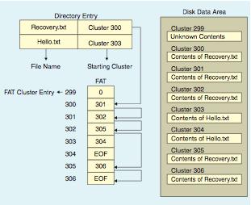
FAT32: How Are Files Stored?

Slide 4
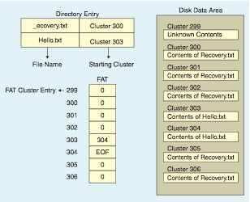
FAT32: How Are Files Deleted?

Slide 5
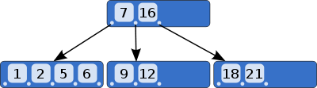
NTFS: How Are Files Stored?
Recovery.txt | Meta-data |  | Clusters
B-tree
X
. . . . .
Bitmap keeps track of cluster usage

Slide 6
NTFS: How Are Files Deleted?
Recovery.txt | Meta-data | X | Clusters
B-tree
X
X
X
X
X
. . . . .
Bitmap keeps track of cluster usage

Slide 7
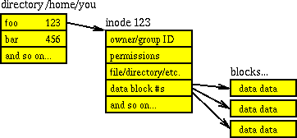
Unix: How Are Files Stored?

Slide 8
Unix: How Are Files Deleted?
X

Slide 9
Unix: Reclaiming Disk Space
Used
inodes list
Free
inodes list
Used
data blocks list
Free
data blocks list
a
a
b
b
Inode: 123
Filename: foo

Slide 10
Meta-data Survives
The name of the file
Meta-data
  Permissions, MAC times, file attributes, etc.
Location (partial) of data
Last directory entries survive
This information can be easily destroyed on a live system

Slide 11
Basic SleuthKit inode Commands
List contents of directory
  icat image.dd 2 | strings
    inode nr 2 corresponds to /
  fls image.dd 2
List all inodes
  ils –a image.dd
Recover file pointed to by inode
  icat image.dd inode-number
Discover directory entries linked to an inode
  ffind

Slide 12
SleuthKit Dealing with Blocks
Recap: inodes hold meta-data, blocks hold content
Summary of inode:
  istat image.dd inode-nr
Show block contents
  blkcat image.dd block-nr
List all blocks
  blkls –e image.dd
  Useful for searching all blocks

Slide 13
Open Files
Deletion is deferred → inode links survive till file is closed
  Get with ils -O
Used
inodes list
Free
inodes list
Used
data blocks list
Free
data blocks list
a
a
b
b
Inode: 123
Filename: foo

Slide 14
File Extensions
Normally indicate content
  EXE → binary
  JPG → Image
  DOCX → Word document
…but not always so
  Applications using a single extension
    Temporary files (.TMP)
  Users intentionally masquerading files

Slide 15
File Signatures
Series of bytes found at specific locations
  Also known as magic numbers
On linux: /usr/share/file/magic
  Or simply use the file command
  E.g., jpeg images:
  0 beshort 0xffd8 image/jpeg

Slide 16
Searching for Strings
The all powerful string command
  E.g., Also report offset of string: strings –t d
Use it on:
  Raw images
  Inode content
  Data block content
Beware of fragmentation

Slide 17
Fragmentation
Content is stored across multiple data blocks
  Search string may be split
  Data blocks may not be stores sequentially
Makes searching and content identification more challenging
Inode: 646
…
..
Direct blocks:
512, 800
… hell
o world

Slide 18
Recovering in the Absence of
Meta-data
Because….
  The inode of the file has been recycled by the file system
  Data are hidden in un-partitioned/unallocated space
Challenge: No way to directly identify the data blocks making up a file
File carving is the process of reassembling such files
  File signatures (beyond magic numbers)
  Heuristics based on FS knowledge

Slide 19

File Carving
Time consuming process
Depends on level of fragmentation
Overall disk fragmentation can be low
  Most files are broken to two fragments (BiFragmentation)
…but high for important files, like email and images

Slide 20
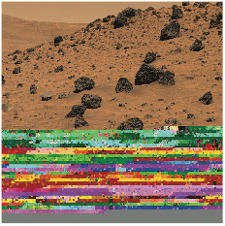
Sequential Carving
Focuses on identifying header and footer
  Combination of magic number signatures and file size
Tools using it: foremost and later scalpel
Suited for un-fragmented files

Slide 21
Graph Theoretic Carving
Assuming a set of unallocated blocks/clusters b₀, …, b_{n}
Compute a permutation Π of the set that corresponds to the structure of the document
W_{x,y} between b_{x} and b_{y} → likelihood of b_{y} following b_{x}
  Maximize the weight of Π, would give us the documents
So how does one determine W?

Slide 22

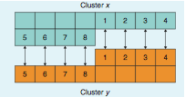
Assigning Weight
Prediction by partial matching (PPM)
  Based on the probability of the following characters
  Better suited for text
Modified for bitmap images
  Difference of width number of pixels used as weight
Taking into account all files improves results

Slide 23
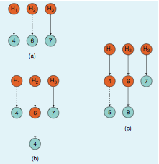
Parallel Unique Path
Variation of Dijkstras single source shortest path algorithm

Slide 24

Bifragment Gap Carving (BGC)
Header and footer are known
Files can be validated
  No TXTs or BMPs
Exhaustive search between header and footer

Slide 25
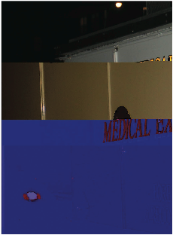
BGC Shortcomings
Cannot handle
  Large gaps
  More than 2 fragments
  Files than can’t be validated
Limitations
  Missing clusters give poor results
  …and validation does not solve everything

Slide 26
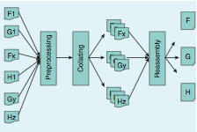
Smartcarver
Three key componets
  Pre-processing (decrypt and decompress)
  Collating
  Reassembly

Slide 27
Classification Techniques
Keywords and patterns
  HTML
ASCII characters frequency
  Rare in audio, image, and vide
Entropy
  Usually unreliable between binary files
File fingerprints
  Byte frequency (better for text and large data-sets)

Slide 28
The Oscar Method
Originally followed byte frequency classification
  Increased accuracy with file specific keywords
Enhanced oscar
  Takes into account the ordering of bytes, Rate Of Change
  RoC = absolute difference between consecutive bytes
M. Karresand and N. Shahmehri, “Oscar file type identification of binary data in disk clusters and RAM pages,” in Proc . IFIP Security and Privacy in Dynamic Environments, vol. 201, 2006, pp. 413–424.
M. Karresand and N. Shahmehri, “File type identification of data fragments by their binary structure,” in Proc. IEEE Information Assurance Workshop, June 2006, pp. 140–147.

Slide 29
Reassembly
How to determine if two clusters should be merged?
  Dictionary: find words split between two clusters
  File structure: length fields, CRC values, etc.

Slide 30
Sequential Hypothesis-Parallel Unique Path (SHT-PUP)
After a best match we look at the clusters following the best match
  It is likely that the following cluster will belong to the file

Slide 31
File Carving Tools
Open source
  Foremost http://foremost.sourceforge.net/
  Scalpel http://www.digitalforensicssolutions.com/Scalpel/
  PhotoRec http://www.cgsecurity.org/wiki/PhotoRec
Commercial
  Recover My Files http://www.recovermyfiles.com/
  EnCase http://www.guidancesoftware.com/encase-forensic.htm
  Adroit http://digital-assembly.com/products/adroit-photo-forensics/features/smartcarving.html
  FTK http://www.accessdata.com/products/digital-forensics/ftk

Slide 32
Challenges
Some types of data look alike
SSD drives are naturally fragmented
Missing clusters significantly raise the bar

Slide 33
Accessing Disk Bad Blocks
Requires access to the hard drive
Disks don’t normally return bad data
  Special commands that disable checking required
  Read Long command (SMART Command Transport)
Unlikely that it will return useful results
  It must be worth it
    Highly valuable data
    Intentional hiding of information
Commercial tool: http://www.atola.com/products/insight

Slide 34
Going Back to Step 1
Capture volatile information
vs.
Unplug and make copies

Slide 35
Recap: Processes
List running processes
  Linux
    ps
    top
    Through /proc
  Windows
    tasklist
    taskmgr

Slide 36
Capturing Memory
Through devices
  RAM - /dev/mem /proc/kcore
  Kernel memory - /dev/kmem
  memdump tool, or cat /proc/kcore
Process memory (only active memory)
  /proc/pid/mem pseudo filesystem
Swap space
  Separate partition on Unix
  File on Windows
Keyboard shortcuts
  Windows: ctrl+scroll lock+scroll lock

Slide 37
The Problem of Memory
Large chunks of (potentially) unknown data
  There is a structure but it is unknown to us
Some help for processes: /proc/pid/maps
00400000-004e0000 r-xp 00000000 08:03 1569796 /bin/bash
006df000-006e0000 r--p 000df000 08:03 1569796 /bin/bash
006e0000-006e9000 rw-p 000e0000 08:03 1569796 /bin/bash
006e9000-006ef000 rw-p 00000000 00:00 0
00a9c000-00d6b000 rw-p 00000000 00:00 0 [heap]
7fe46a923000-7fe46a92f000 r-xp 00000000 08:03 2099083 /lib/x86_64-linux-gnu/libnss_files-2.15.so
7fe46be35000-7fe46be37000 rw-p 00023000 08:03 2099087 /lib/x86_64-linux-gnu/ld-2.15.so
. . . . . . .
7fff28987000-7fff289a8000 rw-p 00000000 00:00 0 [stack]
7fff289ff000-7fff28a00000 r-xp 00000000 00:00 0 [vdso]
ffffffffff600000-ffffffffff601000 r-xp 00000000 00:00 0 [vsyscall]

Slide 38
A Needle in a Haystack
strings and grep are your friends
Use file content or keywords to get a starting point
freebsd # ./dump-mem.pl > giga-mem-img-1
successfully read 1073741824 bytes
freebsd # strings giga-mem-img-1 | fgrep "Supercalif"
freebsd # cat helloworld
Supercalifragilisticexpialidocious
freebsd # ./dump-mem.pl > giga-mem-img-2
successfully read 1073741824 bytes
freebsd # strings giga-mem-img-2 | fgrep "Supercalifr"
Supercalifragilisticexpialidocious
Supercalifragilisticexpialidocious
freebsd #

Slide 39
Recovering Encrypted Data
If data has been decrypted/displayed then they are probably in memory
Example:
  Create an encrypted file
    E.g., in VIM use the X command
  Save the file
  Dump RAM
  Search for encrypted contents

Slide 40

Using Files to Identify RAM chunks
There is no /proc/…/maps for RAM
Data is usually preserved when read from disk
/foo.txt
….
….
MD5
MD5
e6e922f8e624bc7e825619da4aca20fc
e6e922f8e624bc7e825619da4aca20fc
e6e922f8e624bc7e825619da4aca20fc
e6e922f8e624bc7e825619da4aca20fc
Disk
e6e922f8e624bc7e825619da4aca20fc
RAM
e6e922f8e624bc7e825619da4aca20fc

Slide 41
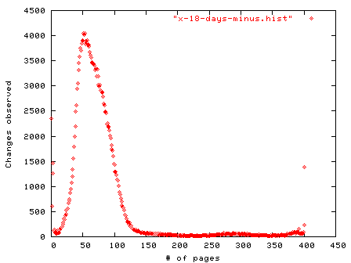
How Frequently Does Memory Change?
Busy Linux server

Slide 42
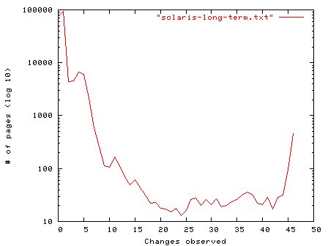
How Frequently Does Memory Change?
Idle Solaris server

Slide 43
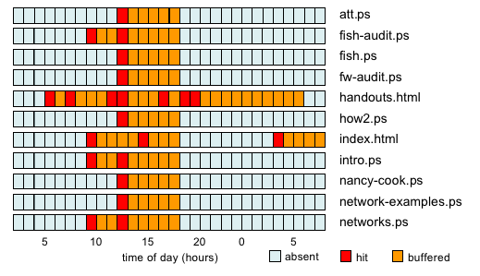
How Long Do Files Stay in Memory?

Slide 44
Memory Persistence
Privately allocated data survive very little after program termination
  Seconds to minutes
  However, data like passwords have been recovered much later
Swap data depend on usage
  Nowadays swap is used less and less
    If something get’s there it tends to survive
Can even survive the boot process
  Cold boot attacks
Kernel memory is harder to directly affect
  Unless you start writing to disk (affects caches)

Slide 45
More on Data Lifetime
Understanding Data Lifetime via Whole System Simulation
Jim Chow, Ben Pfaff, Tal Garfinkel, Kevin Christopher, Mendel Rosenblum
USENIX Security 2004
http://benpfaff.org/papers/taint.html/

Slide 46
Data Are Hard to Destroy
Unpredictability of OSes and compilers
Example:
  Paranoid programmer erases memory
    memset(buf,0,len)
  Compiles program
  Compiler removes call when optimizing

Slide 47
TaintBochs
Bochs IA-32 emulator
  http://bochs.sourceforge.net/
Modified to perform taint analysis
  aka data flow tracking
Track sensitive information as the system executes
  E.g., passwords and encryptions keys

Slide 48
Memory Shadowing
Stores meta-information about RAM
E.g., A bit marking the data as “interesting”
Guest OS
TaintBochs Emulator
Shadow RAM
NIC
Disk
RAM
CPU
Shadow registers
Host OS
addr
shadow_map(addr)→shadow_addr

Slide 49
Data Marking
Sources
  Devices like keyboard, NICs
  Virtual devices are modified to assert shadow memory tags
Custom
  Applications decide what to tag (ssh can mark the encryption key)
  New IA-32 instruction added

Slide 50
Tags Propagation
Every instruction is also “shadowed”
Example: mov eax, ebx
  mov shadow_eax, shadow_ebx
  Note shadow_eax and shadow_ebx are memory locations

Slide 51
Full System Logging
Helps answer: Who has tainted data? How did they get it? and When did that happen?
Log all interesting operations
  Memory writes
  Stack pointer updates
Massive amounts of data → 500 MB/minute raw log data
  It can get worse: Tralfamadore: Unifying Source Code and Execution Experience, EuroSys 2009 (short paper)

Slide 52
(Some) Findings
Applications run
  Mozilla browser
  Apache Web server
Data found surviving in the kernel in
  Circular queues (size dependant)
  I/O buffers (heap implementation dependant)
Types of data
  Strings (passwords?)
  Random number generator data (used to generate encryption keys)

Slide 53
Grading
0.00% | F | 0.00
50.00% | D | 1.00
57.00% | D+ | 1.33
60.00% | C- | 1.67
63.00% | C | 2.00
66.00% | C+ | 2.33
69.00% | B- | 2.67
72.00% | B | 3.00
75.00% | B+ | 3.33
80.00% | A- | 3.67
85.00% | A | 4.00

