Slide 1
Auditing Using
Virtual Machines
CS-695 Host Forensics
Georgios Portokalidis

Slide 2
Recap: Volatile Data
Data “spoils” easily
  In-memory data are ephemeral by nature
Data trustworthiness
  Compromised systems cannot be trusted
Destructive analysis
  The Heisenberg Uncertainty Principle of data gathering and system analysis
    As you capture data in one part of the computer you are changing data in another

Slide 3
Revisiting an Old Incident
Install sshd
Initial attack
Discovery
7/19/2001
8/23/2001
8/20/2001
Further exploitation
Started
investigation
Install sshd

Slide 4

Revisiting an Old Incident
We need to go back in time and observe the attacker’s actions as they happen
A sophisticated
adversary can erase
his tracks
Discovery
8/23/2001
8/20/2001
Started
investigation

Slide 5
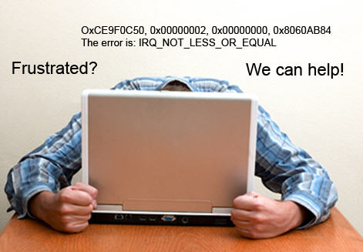
Another group of frustrated users would also live to go back in time.
Guess who?

Slide 6
A Few Words About OS Debugging
Cyclic debugging
  Observe error, revisit previous state, re-run
  Iterate

Slide 7
Similarities
Debugging
Forensics
Can you come up with more similarities or differences?
Can re-run the application
  But execution is non-deterministic
Bug may have been triggered a long time ago
A corrupted OS can interfere with the debugger
Can re-construct deleted files
  Cannot recover/reconstruct volatile data
Initial incident could have occurred a long time ago
A compromised OS can report false data

Slide 8
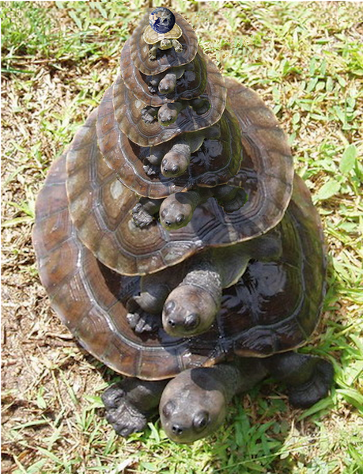
Virtual Machines to the Rescue
System is observed from “below”
  Data may be untrustworthy, but collection does not depend on possibly malicious components (e.g., planted binaries, subverted kernel, etc.)
  The analysis does not tamper with data
Not a panacea!
  Adding more layers does not make a system more secure
  It’s turtles all the way down

Slide 9
VM Overview
Targets
Applications
Guest
Guest
Guest
Inspection code
VM & Host
Operating System
VM
Host
Operating System
Host
Operating System
Hardware
Hardware
Hardware
No VM
VM in the OS
VM as an application

Slide 10
Time Traveling Virtual Machines
Use a software VM to arbitrarily navigate through a previously recorded execution
Samuel T. King, George W. Dunlap, and Peter M. Chen
Debugging operating systems with time-traveling virtual machines
USENIX ATC 2005

Slide 11
Overview
User-mode Linux VM
  Paravirtualization
  15% - 76% overhead
application
application
Guest
operating system
kernel
debugger
VM
[UML: includes host operating system]
debugging stub
Host operating system

Slide 12
Overview
User-mode Linux VM
  Paravirtualization
  15% - 76% overhead
Guest
operating system
kernel
debugger
application
VM
[UML: includes host operating system]
ptrace()
Host operating system

Slide 13
Logging and Replaying
Traveling to a past state is not enough
We need to faithfully replay execution as it originally happened
  Checkpoint VM state at regular intervals
  Log all sources of non-determinism
    Network inputs, the clock, etc.
  “Regenerate” the data when replaying using logged inputs
These steps are the basis of all log & replay systems

Slide 14
Non-deterministic Data in UML
Network, keyboard
  Obtained through system calls
Real-time clock
  Obtained through privileged CPU instruction
  Configure to trap to the VM
Virtual interrupts
  Identify instruction running when interrupt is delivered
  Use performance counters to count number of branches
Why?

Slide 15
George W. Dunlap, Samuel T. King, Sukru Cinar, Murtaza A. Basrai, Peter M. Chen
ReVirt: Enabling Intrusion Analysis through
Virtual-Machine Logging and Replay
2002 OSDI

Slide 16
Supporting Real Devices
Forward low-level I/O operation to real HW
  Allow debugging of kernel drivers
  Increase performance
Guest
operating system
kernel
debugger
application
VM
[UML: includes host operating system]
Host operating system

Slide 17
Accessing the Hardware
IN/OUT assembly instructions
  Privileged instructions can be easily intercepted by the VM
Direct Memory Access
  Guest needs to map host memory
  ReVirt needs to log all accesses of such areas from the guest
    Determinism of inputs needs to be preserved
    Memory pages are protected and a trap is issued for handling guest reads
What could go wrong?
Notes:
DMA can write arbitrary locations in the host

Slide 18
Shared Memory and Determinism
Guest
Host
read
read
read
write
write
read
read
write
read
read

Slide 19
Shared Memory and Determinism
Guest
Host
read
read
read
write
write
read
read
write
read
read

Slide 20
Shared Memory and Determinism
Guest
Host
read
read
read
write
write
read
read
write
read
read

Slide 21

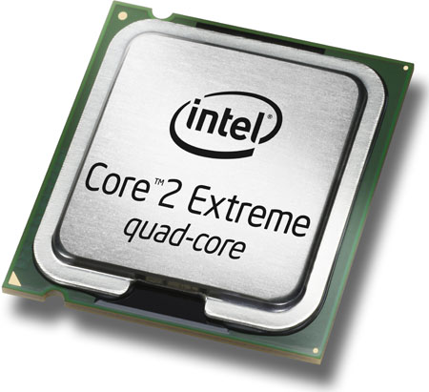
Checkpointing (the naïve way)
Save all state at a given point of time
Too wasteful!
Log only CPU state
CPU
Memory
Disk
Registers
Pages
Blocks

Slide 22
Keeping Track of Modified Memory
checkpointn
write
checkpointn
write
redo
log
undo
log

Slide 23
Keeping Track of Modified Files
checkpointn
write
checkpointn
write
redo
log
undo
log

Slide 24
Time-traveling
checkpoint 1
How to go back to a checkpoint?
Restore checkpoint1 state
Use undo log to restore
memory
files
redo
log
undo
log

Slide 25
Time-traveling
checkpoint 1
How to go back to an arbitrary point?
Restore checkpoint1 state
Use undo log to restore
memory
files
redo
log
undo
log
Redo log to go forward

Slide 26
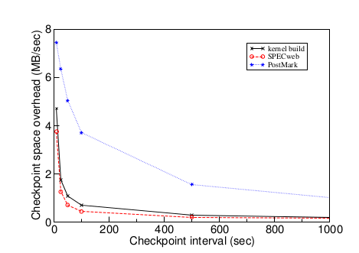
Amount of Data Generated

Slide 27
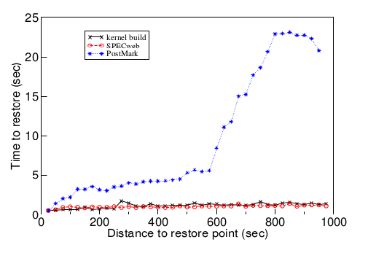
Time to Restore Point

Slide 28
Open Issues
Performance
  Overhead can be between 3%-80%
Extensibility
  Can we easily perform other time of analyses using time traveling?
  Portability
  User-mode Linux requires custom kernel, and can only run Linux

Slide 29
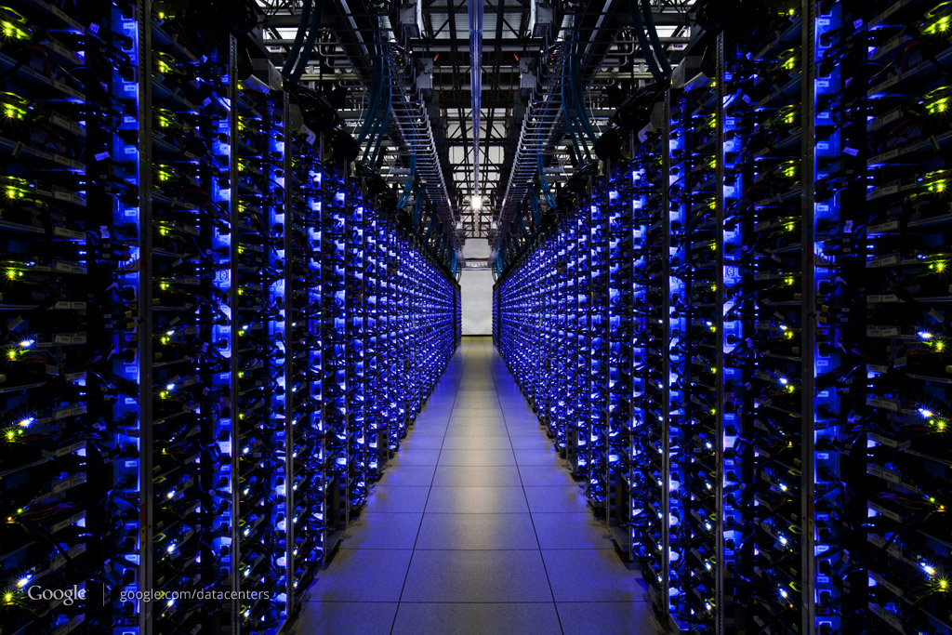
We want this technology on production machines

Slide 30
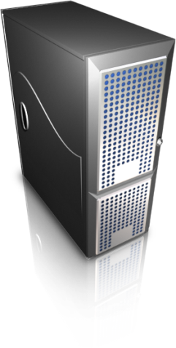
Separate Logging from Replay
Record
Replay
Minimal interference
Extensibility

Slide 31
Separate Logging from Replay
Jim Chow, Tal Garfinkel, and Peter M. Chen
Decoupling dynamic program analysis from execution in virtual environments
USENIX Security 2008
Record
Replay
Minimal interference
Extensibility

Slide 32
Aftersight
Virtual machine based architecture
that decouples execution from
analysis by logging non-deterministic
inputs and replaying them on a
separate platform

Slide 33
Benefits
Can accommodate multiple analyses running on a live system with no additional overhead
Parallel
Uses VMware to log execution
  Hence, more portable
Can replay on different VMs
  VMware (faster, but less extensible)
  Qemu (slower, but very extensible)
Notes:
Heterogeneous replay

Slide 34
More Usage Models
Offline
  Same as time traveling VMs
Online
  Synchronous (explicit synchronization)
    Output is deferred
    Production system is prevented from running too far ahead
  Best effort
    Production system runs full speed
    Analysis results are fed back to determine appropriate actions
← What does this achieve?

Slide 35
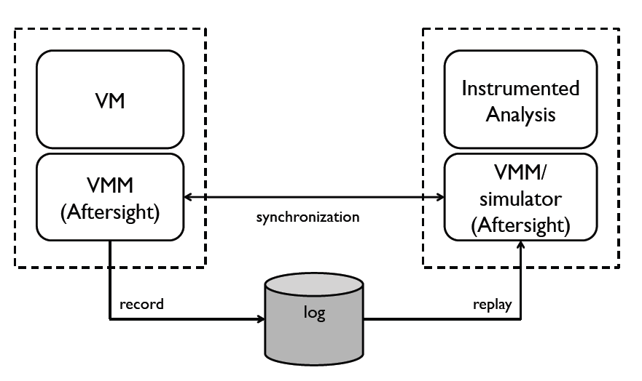
Architecture

Slide 36
Heterogeneous Replay
Logging happens
here
Data given to guest OS
Virtual HW
differs
Guest
Guest
VM
VM
Non-deterministic events from host OS
Recording VM
Replaying VM

Slide 37
What You See Is Not What You Execute
VMs using binary translation (e.g., Qemu) transform the executed instructions
  Performance counters are no longer valid
  Interrupts can only be delivered at basic block boundaries
Performance counters need to be emulated
  Instruction count is obtained before transformation
Basic block are split whenever an interrupt needs to be delivered
  When replaying we know this before hand

Slide 38
Time Traveling on
Smartphones and tablets?

Slide 39
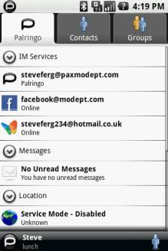
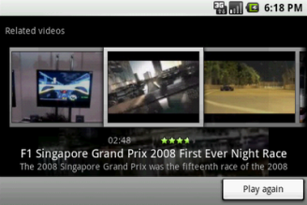
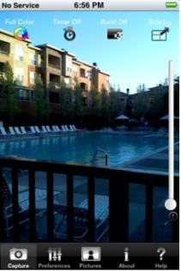
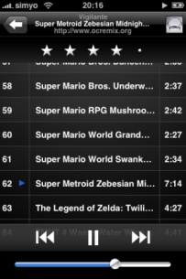
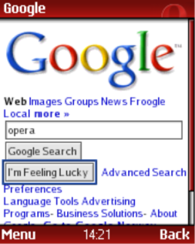
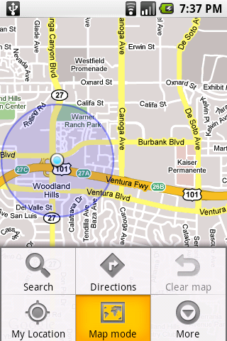
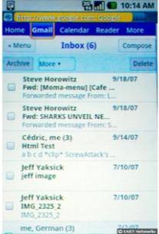
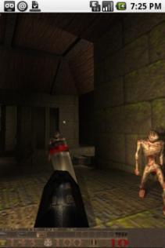
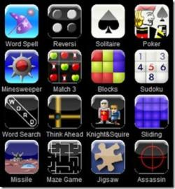
Why?
They are used to “Do things we used to do with computers”
Multimedia
IM
Web & Email
Games

Slide 40

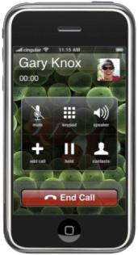
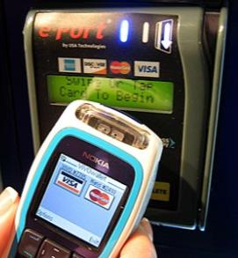
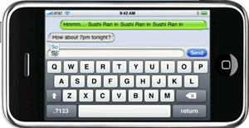
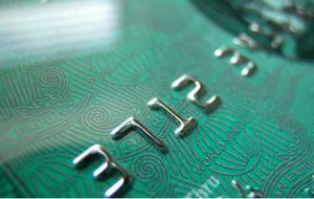


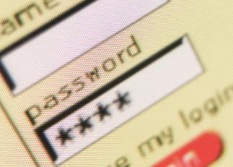

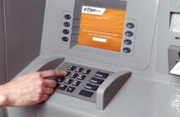
… and More
Micropayments
(parking, transit)
Calls & SMS
Critical information
pins
credit card numbers
passwords
Sensors

Slide 41
Threats
Software vulnerabilities
  iPhone PDF exploit used to jailbreak the device
  Android privilege escalation bugs
Malicious applications being downloaded
  Too many to list …
Physical
  Can be damaged, stolen, manipulated, etc.

Slide 42
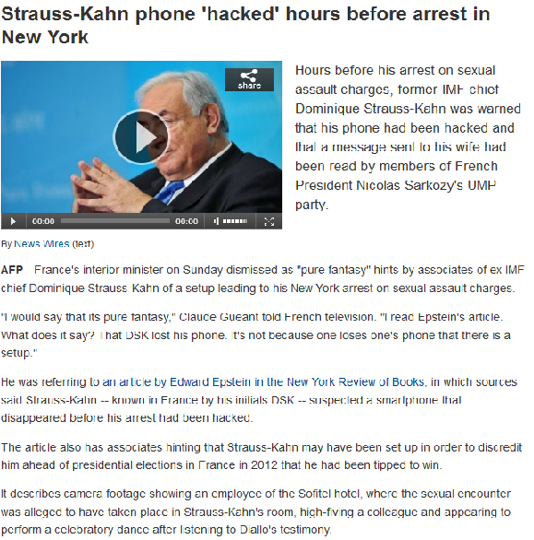

Slide 43
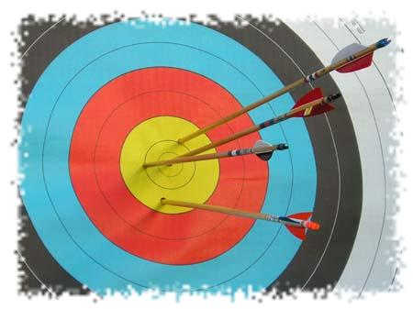
Goals
Enables multiple analyses with fixed overhead
  Including support for heavyweight mechanisms like dynamic taint analysis (DTA)
  Including forensics and auditing
Enable backup and recovery of device data
Prevent attackers from disabling the checks
Low overhead
  No VM
  Minimize volume of generated data

Slide 44
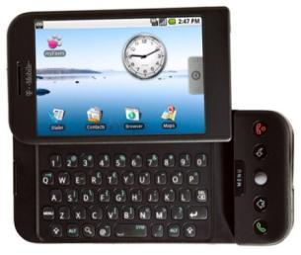

Overview
Faithfully replicate smartphone execution in remote servers
Apply analyses on replicas
….

Slide 45
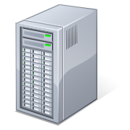
Design Overview
Internet, UMTS
Regular
traffic
Mirrored
traffic
Record
Replay

Slide 46
Synchronization Issues
Transmitting data requires power
  Opportunistic data transmission to server
Connectivity can be lost
  Data need to be temporarily stored in a secure fashion on the device

Slide 47
Recording on the Device
Record non-deterministic events (syscalls, signals, etc)
Encode & compress
Store securely
Transmit to server

Slide 48
Replaying on the Server
Recorded events
Replay execution
Monitoring
Analysis
Intrusion detection
Proxy data
OS
Smartphone emulator

Slide 49
Security Server
We can apply any detection technique that does not interfere with the replicated execution
  System call profiling, file scanning, DTA, etc.
The same as applying the check on the device
Checks can be added transparently
A server can host multiple replicas

Slide 50

Marvin: A Paranoid Android Prototype
Platform
  Android OS 1.6
  HTC G1 developer phone

Slide 51
Device Implementation
Using ptrace()
Record non-deterministic events (syscalls, signals, etc)
Encode & compress
Store securely
Transmit to server
Huffman-style, LZ
HMAC + rolling key
OpenSSL

Slide 52
Implementation Issues
Scheduling and shared memory
  We use deterministic scheduling
  Alternatives
    Kernel space deterministic scheduling
    Concurrent-read-exclusive-write (CREW) protocol
IOCTLS
  Used existing descriptions from the QEMU user space emulator
  Manually added Android related ones
Notes:
Just say we do deterministic scheduling.

Slide 53
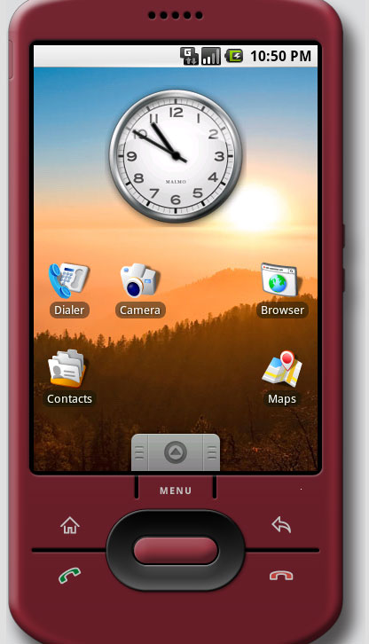
Security Server Implementation
Replica hosted on Android QEMU emulator
Applications
Android OS
QEMU emulator

Slide 54
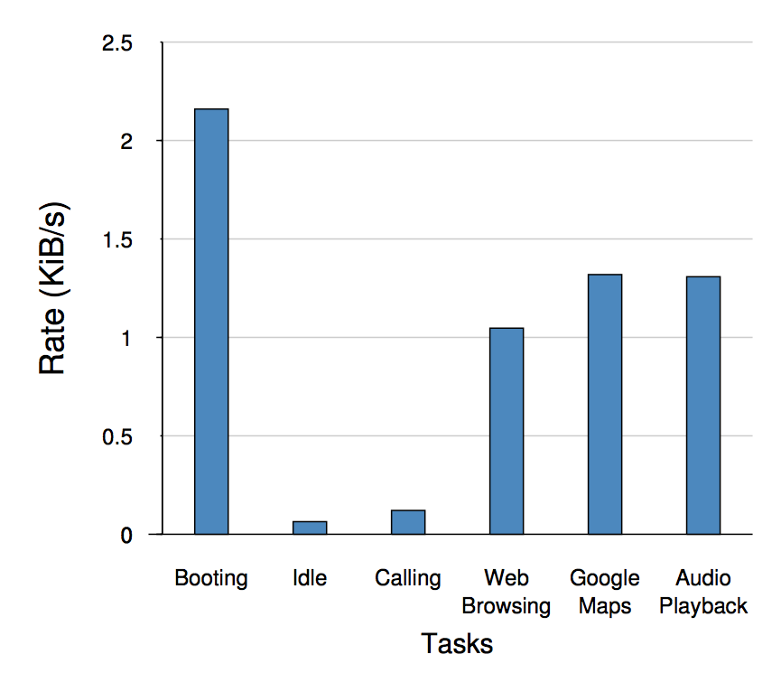
Data Generation Rate for Various Tasks
121B/s
64B/s

Slide 55
Performance
Idle operation and performing calls
  CPU load and battery life are not affected
During intensive usage like browsing
  CPU load average increased by ≈15%
  Battery consumption increased by ≈30%

Slide 56
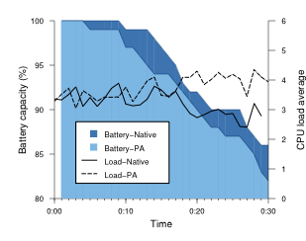
Performance and Energy Consumption

Slide 57
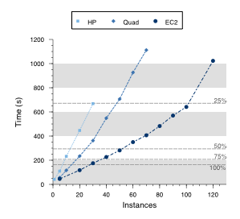
Scalability

