Slide 1
Reverse Engineering
Software
CS-695 Host Forensics
Georgios Portokalidis

Slide 2
Today
Introduction
Static analysis
Dynamic analysis
Challenges

Slide 3
Introduction
Reverse Engineering

Slide 4


Slide 5

In Words
The process of analyzing a system
Understand its structure and functionality
Used in different domains (e.g., consumer electronics)

Slide 6
Reverse Engineering Software
Understand architecture (from source code)
Extract source code (from binary representation)
Change code functionality (of proprietary program)
Understand message exchange (of proprietary protocol)

Slide 7
Software Engineering
First
generation
language
Machine code
0010100011011101
0101010111100010
Assemble
Second
generation
language
Assembly
mov eax, ebx
xor eax, eax
Compile
Third
generation
language
C, Java, …
int x;
while (x<10){

Slide 8
Software Reverse Engineering
First
generation
language
Machine code
0010100011011101
0101010111100010
Disassemble
Second
generation
language
Assembly
mov eax, ebx
xor eax, eax
De-compile
Third
generation
language
C, Java, …
int x;
while (x<10){

Slide 9
A Hard Problem
Fully-automated disassemble/de-compilation of arbitrary machine-code is theoretically an un-decidable problem
Disassembling problems
  How to distinguish code (instructions) from data
De-compilation problems
  Structure is lost
    Data types are lost, names and labels are lost
  No one-to-one mapping
    Same code can be compiled into different (equivalent) assembler blocks
    Assembly block can be the result of different pieces of code

Slide 10
Why?
Software interoperability
  Samba (SMB Protocol)
  OpenOffice (MS Office document formats)‏
Emulation
  Wine (Windows API)‏
  React-OS (Windows OS)‏
Malware analysis
Program cracking
Compiler validation

Slide 11
Binary Analysis
Static analysis
Dynamic analysis

Slide 12
Static Analysis Can…
Identify the file type and its characteristics
  Architecture, OS, executable format, ...
Extract strings in binary
  Commands, password, protocol keywords, ...
Identify libraries and imported symbols
  Network calls, file system, crypto libraries
Disassemble
  Program overview
  Finding and understanding important functions
    By locating interesting imports, calls, strings, ...

Slide 13
Dynamic Analysis Can…
Observe runtime memory
  Extract code after decryption, find passwords...
Trace library/system calls and instructions
  Determine the flow of execution
  Interaction with OS
Debug running process
  Inspect variables, data received by the network, complex algorithms, …
Sniff network data
  Find network activities
  Understand the protocol

Slide 14
Static analysis

Slide 15
Gathering Basic Information
Get some idea about the binary
Strings
porto@ubuntu:~$ file /bin/ls
/bin/ls: ELF 32-bit LSB executable, Intel 80386, version 1 (SYSV), dynamically linked (uses shared libs), for GNU/Linux 2.6.24,BuildID[sha1]=0x274c7a324a48f28c5c5f80cfbbd9becec6bcebe5, stripped
porto@ubuntu:~$ strings /bin/ls|head
/lib/ld-linux.so.2
2zL'
,cr<
libselinux.so.1
_ITM_deregisterTMCloneTable
__gmon_start__
_Jv_RegisterClasses

Slide 16
ELF Information
readelf
porto@ubuntu:~$ readelf -h /bin/ls
ELF Header:
Magic: 7f 45 4c 46 01 01 01 00 00 00 00 00 00 00 00 00
Class: ELF32
Data: 2's complement, little endian
Version: 1 (current)
OS/ABI: UNIX - System V
ABI Version: 0
Type: EXEC (Executable file)
Machine: Intel 80386
Version: 0x1
Entry point address: 0x804be68
Start of program headers: 52 (bytes into file)
Start of section headers: 107492 (bytes into file)
Flags: 0x0
Size of this header: 52 (bytes)
Size of program headers: 32 (bytes)
Number of program headers: 9
Size of section headers: 40 (bytes)
Number of section headers: 28
Section header string table index: 27

Slide 17
ELF Information
elfsh – eresi project
[ELF HEADER]
[Object /bin/ls, MAGIC 0x464C457F]
Architecture : Intel 80386 ELF Version : 1
Object type : Executable object SHT strtab index : 27
Data encoding : Little endian SHT foffset : 0000107508
PHT foffset : 0000000052 SHT entries number : 30
PHT entries number : 9 SHT entry size : 40
PHT entry size : 32 ELF header size : 52
Runtime PHT offset : 1179403657 Fingerprinted OS : Linux
Entry point : 0x0804BE68 [?]
{OLD PAX FLAGS = 0x0}
PAX_PAGEEXEC : Disabled PAX_EMULTRAMP : Not emulated
PAX_MPROTECT : Restricted PAX_RANDMAP : Randomized
PAX_RANDEXEC : Not randomized PAX_SEGMEXEC : Enabled

Slide 18
Libraries
Easy for dynamically linked programs
Difficult for statically linked programs
porto@ubuntu:~$ ldd /bin/ls
linux-gate.so.1 => (0xb76fa000)
libselinux.so.1 => /lib/i386-linux-gnu/libselinux.so.1 (0xb76ca000)
librt.so.1 => /lib/i386-linux-gnu/librt.so.1 (0xb76c1000)
libacl.so.1 => /lib/i386-linux-gnu/libacl.so.1 (0xb76b7000)
libc.so.6 => /lib/i386-linux-gnu/libc.so.6 (0xb750d000)
libdl.so.2 => /lib/i386-linux-gnu/libdl.so.2 (0xb7508000)
/lib/ld-linux.so.2 (0xb76fb000)
libpthread.so.0 => /lib/i386-linux-gnu/libpthread.so.0 (0xb74ed000)
libattr.so.1 => /lib/i386-linux-gnu/libattr.so.1 (0xb74e7000)

Slide 19
Inside linux-gate.so.1
porto@ubuntu:~$ cat /proc/self/maps|grep vdso
b7fdd000-b7fde000 r-xp 00000000 00:00 0 [vdso]
. . .
porto@ubuntu:~$ echo "obase=10; ibase=16; B7FDD000/1000" | bc
753629
porto@ubuntu:~$ dd if=/proc/self/mem bs=4096 skip=753629 count=1 of=vdso
porto@ubuntu:~$ objdump –d vdso
vdso: file format elf32-i386
Disassembly of section .text:
fffe414 <__kernel_vsyscall>:
ffffe414: 51 push %ecx
ffffe415: 52 push %edx
ffffe416: 55 push %ebp
ffffe417: 89 e5 mov %esp,%ebp
ffffe419: 0f 34 sysenter
ffffe41b: 90 nop
ffffe41c: 90 nop
. . .

Slide 20
Used Library Functions
Easy for dynamically linked programs
Difficult for statically linked programs
porto@ubuntu:~$ nm -D /bin/ls |head
U abort
U acl_extended_file_nofollow
U acl_get_entry
U acl_get_tag_type
U __assert_fail
U bindtextdomain
080622e0 B __bss_start
U calloc
U clock_gettime
U closedir

Slide 21
Recognizing Libraries in
Statically-linked Code
Basic idea
  Create a checksum (hash) for bytes in a library function
Problems
  Many library functions (some of which are very short)
  Variable bytes – due to dynamic linking, load-time patching, linker optimizations
Solution
  More complex pattern file
  Uses checksums that take into account variable parts
  Implemented in IDA Pro as:
    Fast Library Identification and Recognition Technology (FLIRT)

Slide 22
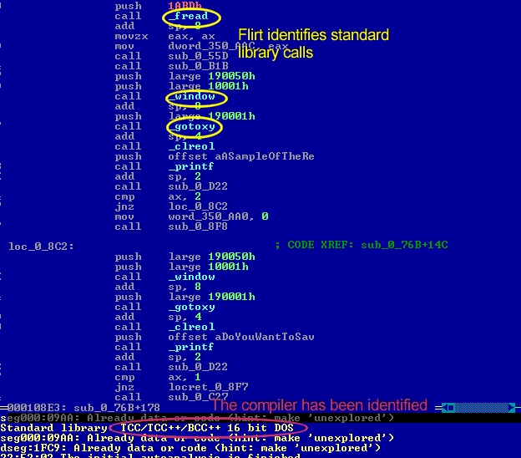
Original Source Code
(some lines snipped for brevity's sake)
offset = fread((char *)workblock... do_after_key();
window(1,1,80,25);
gotoxy(1,25);
clreol();
printf("A sample of the re...
if( is_ok() == 2) {
enc_string_offset = 0;
key_adjust();
}

Slide 23
Program Symbols
Used for debugging and linking
Function names (with start addresses)
Global variables
Use nm to display symbol information
Most symbols can be removed with strip

Slide 24
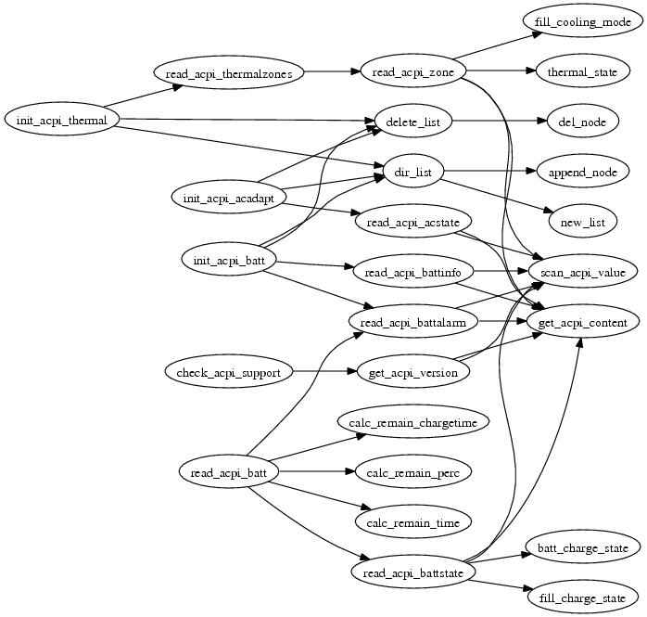
Function Call Trees or Graphs
Which function calls which others?
Reveals program structure

Slide 25
Disassembly
The process of translating binary stream into machine instructions
Varying level of difficulty
  Depending on ISA (instruction set architecture)
Instructions can have
  Fixed length
    More efficient to decode for processor
    RISC processors (SPARC, MIPS)
Variable length
  Use less space for common instructions
  CISC processors (Intel x86)

Slide 26
Fixed vs. Variable Length Instructions
Fixed length instructions
  Easy to disassemble
  Take each address that is multiple of instruction length as instruction start
  Even if code contains data (or junk), all program instructions are found
Variable length instructions
  More difficult to disassemble
  Start addresses of instructions not known in advance
  Different strategies
    Linear sweep disassembler
    Recursive traversal disassembler
  Disassembler can be desynchronized with respect to actual code

Slide 27
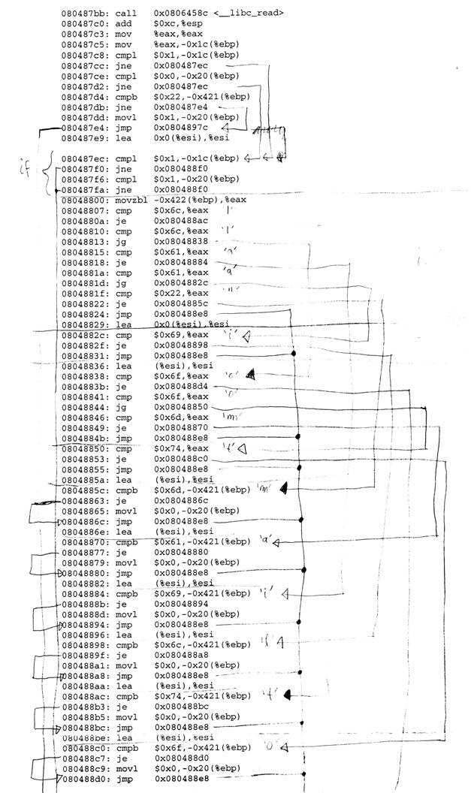
X86 Assembly

Slide 28
Reading It
Assembler Language
  Human-readable form of machine instructions
  Must understand the hardware architecture, memory model, and stack
AT&T syntax
  Mnemonic source(s), destination
  Standalone numerical constants are prefixed with a $
  Hexadecimal numbers start with 0x
  Registers are specified with %
  Preferred by UNIX (objdump, etc.)
Intel syntax
  Mnemonic destination, source(s)
  Hexadecimal numbers end with h
  Used by IDA Pro

Slide 29
Registers
Local variables of processor
Six 32-bit general purpose registers
  Can be used for calculations, temporary storage of values, …
  %eax, %ebx, %ecx, %edx, %esi, %edi
Several 32-bit special purpose registers
  %esp - stack pointer
  %ebp - frame pointer
  %eip - instruction pointer
EFLAGS: the status register
Segment registers:
  CS (code),
  SS (stack),
  DS (data),
  ES (extra),
  FS, GS - Artifact of old 8086 processor

Slide 30
Important Mnemonics (Instructions)
mov data transfer
pop / push stack operations
add / sub arithmetic
cmp / test compare two values and set control flags
je / jne conditional jump depending on control flags (branch)
jmp unconditional jump

Slide 31
ALU Instructions
ADD, SUB, AND, OR, XOR, …
MUL and DIV require specific registers
Shifting takes many forms:
  Arithmetic shift right preserves sign
  Logic shifting inserts 0s to front
  Rotate can also include carry bit (RCL, RCR)
Shift, rotate and XOR instructions are a tell-tale sign of encryption/decryption

Slide 32
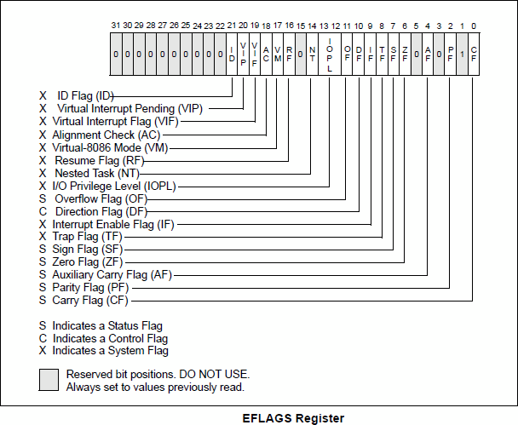
The EFLAGS Register

Slide 33
Frequently Used Flags
The EFLAGS register is
  used for control flow decision
  set implicit by many operations (arithmetic, logic)
Flags typically used for control flow
  CF (carry flag)
    Set when operation “carries out” most significant bit
  ZF (zero flag)
    Set when operation yields zero
  SF (signed flag)
    Set when operation yields negative result
  OF (overflow flag)
    Set when operation causes 2’s complement overflow
  PF (parity flag)
    Set when the number of ones in result of operation is even

Slide 34
How Are Flags Set?
Can be
  Implicit, as a side effect of many operations
  Explicit, as a result of compare / test operations
Compare cmp b, a [ note the order of operands ]
  Computes (a – b) but does not overwrite destination
  Sets ZF (if a == b), SF (if a < b) [ and also OF and CF ]
How is a branch operation implemented
  Typically, two-step process
    First, a compare/test instruction
    Followed by the appropriate jump instruction

Slide 35
How Are Flags Used?
Instruction | Synonym | Jump condition | Description
jmp label jmp *operand |  | 1 1 | Direct jump Indirect jump
je label jne label | jz jnz | ZF ~ZF | Equal/zero Not equal/zero
jg label jge label jl label jle label | jnle jnl jnge jng | ~(SF ^ OF) & ~ZF (~SF ^ OF) SF ^ OF (SF ^ OF) | ZF | greater than (signed) greater or equal (signed) less than (signed) less or equal (signed)
ja label jae label jb label jbe label | jnbe Jnb jnae jna | ~CF & ~ZF ~CF CF CF | ZF | above (unsigned) above or equal (unsigned) below (unsigned) below or equal (unsigned)
js label jns label |  | SF ~SF | Negative Non-negative

Slide 36
Memory Addressing
Memory is just a linear (flat) array of memory cells (bytes)
  Accessed in different ways (called addressing modes)
Most general fashion
  Address: displacement(%base, %index, scale)
    Where the result address is displacement + %base + %index*scale
Simplified variants are also possible
  Use only displacement → direct addressing
  Use only single register → register addressing

Slide 37
Byte Order
Important for multi-byte values (e.g., four byte long value)
Intel uses little endian ordering
  Less significant bytes first
  How is 0x03020100 represented in memory?
    0x040 0
    0x041 1
    0x042 2
    0x043 3

Slide 38
Stack
Managed using
  The stack pointer (%esp)
  The frame pointer (%ebp)
Special access commands (push, pop)
  Write/read to/from the stack
  Implicitly alter %esp
Special control flow commands (call, ret)
  Do push/pop and jmp
Common uses
  Function arguments
  Function return address
  Local arguments

Slide 39
Function Calls
CALL addr saves current EIP on stack, changes EIP to addr
  addr can be immediate or register
RET pops of top of stack, setting EIP back to the value retrieved from stack
Argument passing performed by the application, calling conventions ensure compatibility
  Standard C convention (cdecl): Arguments pushed on stack right-to-left, return value in EAX, calling function cleans stack (i.e., removes arguments)
  Microsoft Win32 convention (stdcall): Same as standard convention, but called function cleans stack
Register preservation conventions determines who saves a register that needs to be preserved by a function call
  Caller-saved registers: registers that can be changed by a called function, saved by the callee
  Callee-saved registers: registers that should not be changed by a called function, saved by the called
Stack also used for local variables, allocation performed by changing stack pointer
Malicious programs do not need to adhere to such conventions!

Slide 40
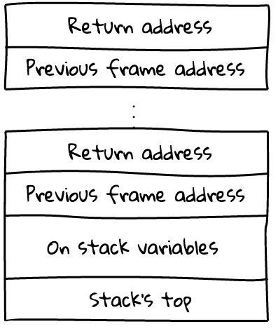
Stack Frame
Helps debuggers locate local variables, etc.
Top of stack frame is stored in EBP
  Old EBP is saved in stack
  Part of the function prologue
  push %ebp
  mov %esp, %ebp
  Matching epilogue
    leave

Slide 41
Tricks
xor %eax, %eax (alternatively sub)
  Sets register to 0
lea (%eax + %eax * 4), %eax
  Multiplication by 5
movb %ah, %al
  Shifting 16 bit to the right by 8 positions

Slide 42
A (Very) Small Assembly Program
# no input
# returns a status code, you can view it by typing echo $?
# %ebx holds the return code
.section .data
.section .text
.globl _start
_start:
mov $1, %eax # This is the system call for exiting program
movl $0, %ebx # This value is returned as status
int $0x80 # This interrupt calls the kernel, to execute sys call

Slide 43
Compiling Assembly
We need to assemble and link the code
  This can be done by using the assembler as (or gcc)
Assemble
  as exit.s –o exit.o
  gcc –c –o exit.o exit.s
Link
  ld –o exit exit.o
  gcc –nostartfiles –o exit exit.o

Slide 44
Build a Simple Program
Task: Find the maximum of a list of numbers
First need to figure out the following
  Where will the numbers be stored?
  How do we find the maximum number?
  How much storage do we need?
  Will registers be enough or is memory needed?
Let us designate registers for the task at hand:
  %edi holds position in list
  %ebx will hold current highest
  %eax will hold current element examined

Slide 45
The Algorithm
Check if %eax is zero (i.e., termination sign)
  If yes, exit
  If not, increase current position %edi
Load next value in the list to %eax
  We need to think about what addressing mode to use here
Compare %eax (current value) with %ebx (highest value so far)
  If the current value is higher, replace %ebx
Repeat

Slide 46
Initializing
.section .data
data_items:
.long 3,67,34,222,45,75,54,34,44,33,22,11,66,0
.section .text
.globl _start
_start:
movl $0, %edi # Reset index
movl data_items(,%edi,4), %eax
movl %eax, %ebx #First item is the biggest so far

Slide 47
The Main Loop
start_loop:
cmpl $0, %eax
je loop_exit
incl %edi # Increment edi
movl data_items(,%edi,4), %eax # Load the next value
cmpl %ebx, %eax # Compare ebx with eax
jle start_loop # If it is less, just jump to the beginning
movl %eax, %ebx # Otherwise, store the new largest number
jmp start_loop
loop_exit:
movl $1, %eax # Remember the exit sys call? It is 1
int $0x80

Slide 48
More Assembly
if statement
{
int a;
if (a < 0) {
printf(“A < 0\n”);
} else {
printf(“A >= 0\n”);
}
}
.LC0:
.string "A < 0\n"
.LC1:
.string "A >= 0\n"
main:
cmpl $0, -4(%ebp) /* compute: a – 0 */
jns .L2 /* jump, if sign bit
not set: a >= 0 */
movl $.LC0, (%esp)
call printf
jmp .L3
.L2:
movl $.LC1, (%esp)
call printf
.L3:

Slide 49
More Assembly
while statement
{
int i;
i = 0;
while(i < 10)
{
printf("%d\n", i);
i++;
}
}
.LC0:
.string "%d\n“
main:
movl $0, -4(%ebp)
.L2:
cmpl $9, -4(%ebp)
jle .L4
jmp .L3
.L4:
movl -4(%ebp), %eax
movl %eax, 4(%esp)
movl $.LC0, (%esp)
call printf
leal -4(%ebp), %eax
incl (%eax)
jmp .L2
.L3:
leave
ret

Slide 50
Disassembly

Slide 51
Types of Disassembly
Linear sweep disassembler
  Start at beginning of code (.text) section
  Disassemble one instruction after the other
  Assume that well-behaved compiler tightly packs instructions
  objdump -d uses this approach
Recursive traversal disassembler
  Aware of control flow
  Start at program entry point (e.g., determined by ELF header)
  Disassemble one instruction after the other, until branch or jump is found
  Recursively follow both (or single) branch (or jump) targets
  Not all code regions can be reached
    Indirect calls and jumps use a register to calculate target during run time
  For these regions, linear sweep is used
  IDA Pro uses this approach

Slide 52
IDA Pro
Recursive decent disassembler
Interactive & Iterative
Scriptable (Python & C-like language)
Used to analyze malware

Slide 53
How to Start
IDA Pro 5.0 free for 32-bit Windows
IDA Pro 6.3 demo for 32-bit Windows, Linux, or Mac
Save work by dumping to IDC
  File → Produce File → Dump Database to IDC file
Open work by re-opening binary and loading IDC file
  File → Script File

Slide 54
A First Look
The Disassembly window
  Use SPACE to switch between text and graph
Imports and Exports window
Functions resolved by the loader
  Binary can still load additional functions!

Slide 55
Data Displays
Strings window
  View → Open Subviews → Strings
Stack view window
  Edit → Functions → Stack variables...
  or double click the variable

Slide 56


Data Display
The Structures view
  May or may not give information
  More stuff on detecting data structures in the next lecture
  Structure types can be assigned to variables
The Enums view
  Define constants

Slide 57

Navigation
You can double click on almost everything
  Arrows in graph view
  Addresses, symbols, variables, ...
  Go back by pressing ESC, the back button, or through the Jump menu
Use Xrefs to find code and data references
  Who calls this function?
    Jump → List cross references to
  Who uses this data?
    Jump → List cross references to

Slide 58
Interaction: Naming
Rename variables and functions
  Edit → Rename (N)
Assigning type information
  Functions
    Edit → Functions → Set type... (Y)
  Variables
    Edit → Set type...(Y), in stack window
    Edit → Struct var
  Constants
    Edit → Operand type ► Enum member

Slide 59
Interaction: Editing
Change word width
  Edit → Data (D)
  Useful when defining structs members.
  Handy when you mess up the stack with wrong type info!
Make arrays or strings
  Edit → Array | String
Add comments
  Edit → Comments → Add comments (:)
Edit anything!
  Using the Hex-View

Slide 60
Correcting Disassembly
You can redefine stuff
  From code to data, and vice-versa
    Edit → Code | Data | Undefine
When?
  Disassembly gets desynchronized (i.e., when IDA is wrong)
  After deobfuscation/decryption of data (i.e., data is now code)

Slide 61
More Information
https://www.hex-rays.com

Slide 62
Dynamic analysis

Slide 63
General Information
The proc filesystem
  /proc/<pid>/ for a process with pid <pid>
  Interesting entries
  cmdline (show command line)
  environ (show environment)
  maps (show memory map)
  fd (file descriptor to program image)
File system interaction
  lsof
  Lists all open files associated with processes

Slide 64
General Information
Windows Registry
  Process Monitor (Sysinternals)
Network interaction
  Check for open ports
    netstat
    Processes that listen for requests or that have active connections
    Also shows UNIX domain sockets used for IPC
  Check for actual network traffic
    tcpdump
    wireshark

Slide 65
Calls
System calls
  Allow user applications to access OS services
  Reveal much about a process’ operation
  strace
    Powerful tool that can also
    Follow child processes
    Decode more complex system call arguments
    Show signals
    Works via the ptrace interface
Library functions
  Similar to system calls, but dynamically linked libraries
  ltrace

Slide 66
Execute Analyzed Binary
Use a controlled environment
  sandbox / debugger
    Isolates binary from the rest of the system
Advantages
  Can inspect actual program behavior and data values
  (At least one) target of indirect jumps (or calls) can be observed
Disadvantages
  May accidentally launch attacks
  Anti-debugging mechanisms
  Not all possible traces can be seen

Slide 67
Debuggers
Common features
  Add breakpoints to pause execution
    When execution reaches a certain point (address)
    When specified memory is access or modified
  Examine memory and CPU registers
  Modify memory and execution path
Advanced features
  Attach comments to code
  Data structure and template naming
  Track high level logic
  Function fingerprinting
Examples:
  gdb for Linux
  Ollydbg for Windows

Slide 68
ptrace()
System call for debugging on x86 Linux
Allows a process (parent) to monitor another process (child)
Whenever the child process receives a signal, the parent is notified
  Parent can then
    Access and modify memory image (peek and poke commands)
    Access and modify registers
    Deliver signals
Can also be used for system call monitoring

Slide 69
Breakpoints
Types
  Hardware breakpoints
  Software breakpoints
Hardware breakpoints
  Special debug registers (e.g., Intel x86)
  Debug registers compared with PC at every instruction
Software breakpoints
  Debugger inserts (overwrites) target address with an int 0x03 instruction
  Interrupt causes signal SIGTRAP to be sent to process
  Debugger
    Gets control and restores original instruction
    Single steps to next instruction
    Re-inserts breakpoint

Slide 70
Challenges

Slide 71
A Tough Problem
Reverse engineering is difficult by itself
  A lot of data to handle
  Low level information
  Creative process, experience very valuable
  Tools can only help so much
Additional challenges
  Compiler code optimization
  Code obfuscation
  Anti-disassemble techniques
  Anti-debugging techniques

Slide 72
Anti-Disassembly
Against static analysis (disassembler)
Confusion attack
  Targets linear sweep disassembler
  Insert data (or junk) between instructions and
  Let control flow jump over this garbage
  Disassembler gets desynchronized with true instructions
jmp Label1 8048000: 74 02 je 8048004
.short 0x4711 8048002: 47 inc %edi
8048003: 11 90 90 90 90 90 adc %edx,0x90909090(%eax)
Label1: 8048004: <Label1>

Slide 73
Anti-Assembly
Advanced confusion attack
  Targets recursive traversal disassembler
  Replace direct jumps (calls) by indirect ones (branch functions)
  Force disassembler to revert to linear sweep, then use previous attack

Slide 74
Anti-Debugging
Detect tracing
  A process can be traced only once
  if (ptrace(PTRACE_TRACEME, 0, 1, 0) < 0)
  exit(1);
Detect breakpoints
  Look for int 0x03 instructions
  if ((*(unsigned *)((unsigned)<addr>+3) & 0xff)==0xcc)
  exit(1);
Checksum the code
  if (checksum(text_segment) != valid_checksum)
  exit(1);

