Slide 1
Discovering Data Structures
CS-695 Host Forensics
Georgios Portokalidis

Slide 2
Why Data?
Assembly instructions can seem cryptic at times
mov %edx, %eax
inc 4(%eax)
mov 0x0, 8(%eax)
lea 12(%eax), %ebx
mov 0(%ebx, 1, 4), %ecx
add 0(%ebx, 2, 4), %ecx
mov %ecx, 0(%ebx, 3, 4)

Slide 3
Why Data?
Assembly instructions can seem cryptic at times
Understanding data structure makes it easier
mov %edx, %eax
inc 4(%eax)
mov 0x0, 8(%eax)
lea 12(%eax), %ebx
mov 0(%ebx, 1, 4), %ecx
add 0(%ebx, 2, 4), %ecx
mov %ecx, 0(%ebx, 3, 4)
structure A {
unsigned int counter;
unsigned int flags;
int array[4];
};
array

Slide 4

The Big Picture
Programs may seem independent
Software
Hardware
In fact, there are many dependencies
Other
software
Libraries
Known
APIs
Software
Structured
data
Unknown
Kernel
Essentially, the software kernel is smaller

Slide 5
Challenges
We can detect objects through pointers
  But which objects are of the same…
    Type
    Size
Semantics need to be extracted
  E.g., a sequence of null terminated characters is probably a string
  Things can easily get tricky!
    Consider Unicode strings
Ignore noise
  Freed but still present memory chunks
  Memory management meta-data
  Data with multiple personalities
    A large integer could be easily confused with a memory address

Slide 6
Digging For Data Structures (OSDI 2008)
Anthony Cozzie, Frank Stratton, Hui Xue, and Samuel T. King
or
Howard: a dynamic excavator for reverse engineering data structures (NDSS 2011)
Asia Slowinska, Traian Stancescu, and Herbert Bos

Slide 7

Laika
A machine learning approach
Given a memory image
  Collect object features
  Write a classifier
  Detect data structures!
Seems simple enough

Slide 8
Block Types
The main data feature, later used for classification
Every machine word is assigned a block type
  Address
    Points to stack or heap
  Zero
  String
  Data

Slide 9
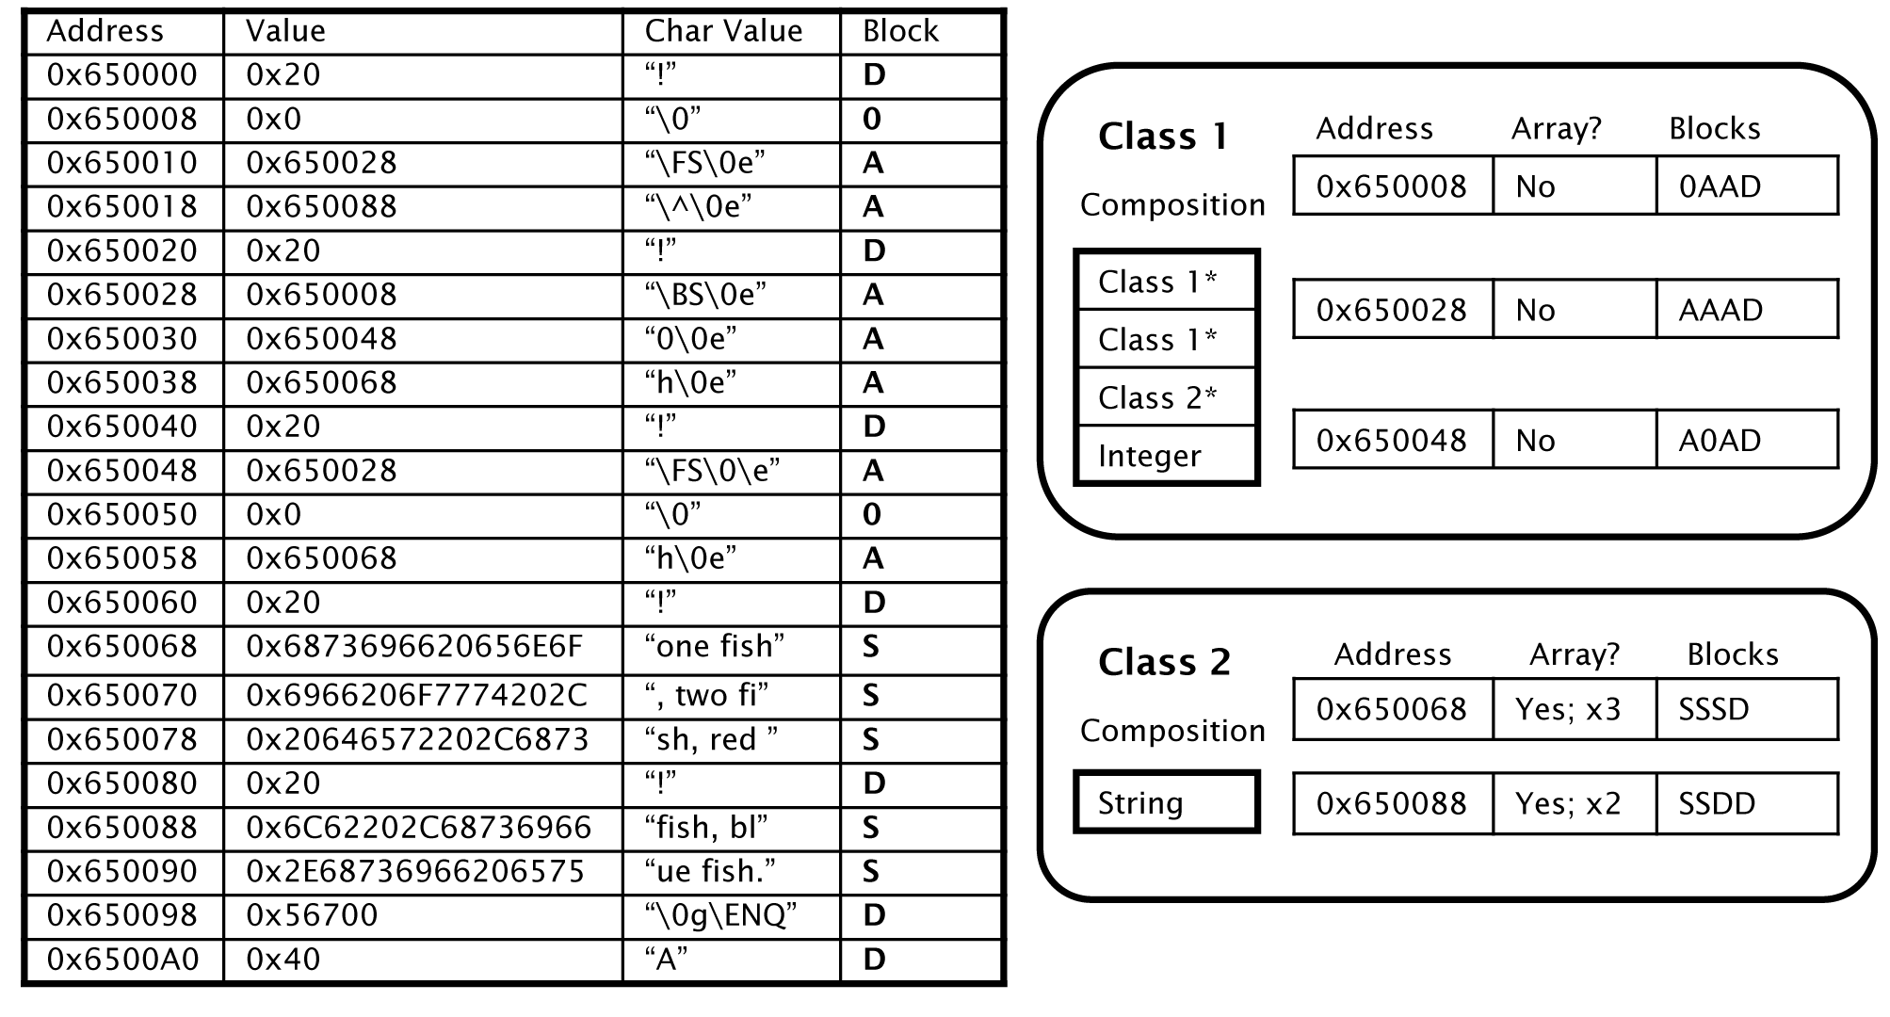
Assumption: similar objects have similar block type vectors

Slide 10
Atomic Types
Basically a block type
  Leaves room for error
    Data can be misclassified as pointers
    Unions
    Uninitialized pointers
  A Probability array is defined for an atomic type being any of the block types
Atomic type vectors form classes (i.e., structures)

Slide 12
Limitations of Approach
Data not contained in machine words
  Unaligned pointers
  Larger/smaller data chunks
    E.g., 16-bit, 64-bit numbers on 32-bit systems, etc.

Slide 13
Estimating Object Size
PTR
PTR
Class associated with object can be smaller
Object
Class
Distance between pointers
The remainder is considered noise
Noise

Slide 14
Malloc
Allocators maintain meta information
  E.g., the size of an allocated chunk
But…
  Too many different allocators
  Custom allocators in many applications
Locality
  Similar sized objects are close to each other

Slide 15
Heuristics
Typed pointers
  Pointers contained in classes always point at the same type
More dependencies, more complexity
No opaque pointers
class A {
int counter;
int flag;
unknown_class *ptr;
}
class B
Class B

Slide 16
Heuristics II
Dynamically-sized Arrays
  E.g., Strings
An object can identified as a continuous set of instantiations of a given class

Slide 17
Putting It All Together
“Bayesian unsupervised learning algorithms compute a joint probability over the classes and the classification, and then select the most likely solution”
  If you like probabilities, check the paper for equations
Implemented in Lisp

Slide 18
How to Check It Works?
What is the ground truth?
  Frequently it is hard to determine
  Necessary in any work that involves experimentation
Created a set of application for evaluation purposes
  Debugging symbols retained
  Minimal optimizations
Custom malloc logs call site, allocation size
  Source code is used to determine type

Slide 19
Interesting Numbers
Less than 1% of pointers are unaligned
Only 1% of integers and 3% of strings point into the heap
About 80% of pointers point to the head of objects
Only 45% of a program’s heap address space is occupied by active objects
Only 30% of objects contain a pointer

Slide 20
Optimizations that Impede Classification
Tail accumulator arrays
How would you allocate a new instance of the following structure?
How about this?
struct mystring {
char *data;
size_t len;
};
struct mystring {
size_t len;
char data[1];
};
Single allocation
ptr = malloc(sizeof(struct mystring) + string_len)

Slide 21
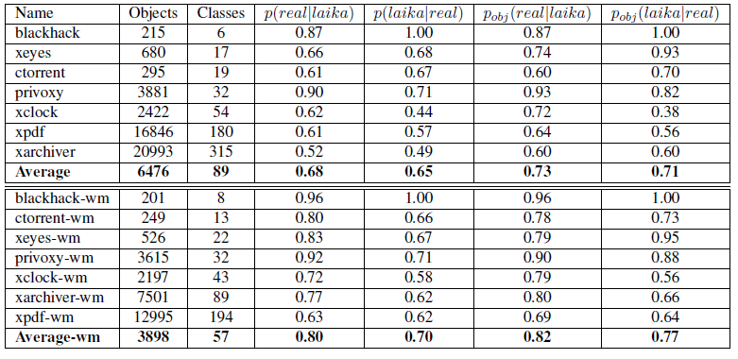
Accuracy
Objects in the same Laika class come from the same real class
Two objects from the same real class were grouped together
Remove random information (malloc meta-data, freed chunks, etc.)

Slide 22
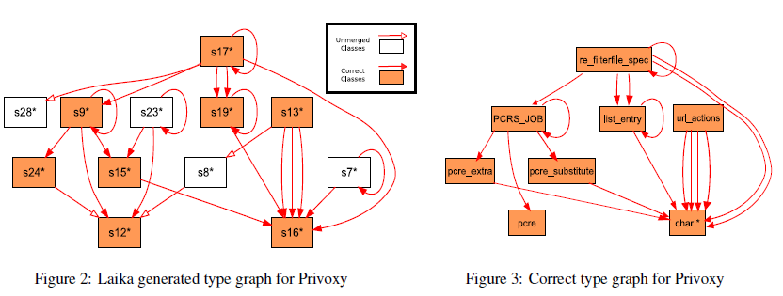
Example Structure Identification
Privoxy

Slide 23
Applying Data Structure Detection on Intrusion Detection
Can we find similar programs by comparing their data structures?
Is it harder to obfuscate a program’s data structures than its code?

Slide 24
Summary
Laika is essentially a static analysis approach
  Can include some dynamic information
    E.g., instrumented malloc
How can we use more dynamic information to improve results?

Slide 25
REWARDS
Dynamic method that executes and monitors a binary
  Collected data are used to infer data types and data semantics
    E.g., Memory accesses
Goals: Identify
  Data types
  Semantics (e.g., an integer is an IP address)
Automatic Reverse Engineering of Data Structures from Binary Execution (NDSS 2010)
Zhiqiang Lin, Xiangyu Zhang and Dongyan Xu

Slide 26
Methodology
Memory accesses tag data with a type attribute
Data copying results in tags being propagated in memory and registers
Data are revealed when data are used in “type sinks”
  System and library calls
  Type revealing instructions

Slide 27
Collected Information
Memory accesses
  Address accessed
  Width of access
  Instruction used for access
    E.g., floating point instruction, signed or unsigned instruction, etc.
  Execution context
    Program counter, stack pointer, etc.
Known calls
  Function or system call made
  Parameters

Slide 28
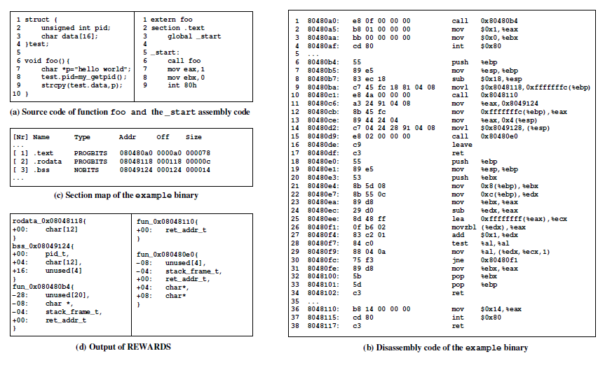
How Are Types Inferred

Slide 29
Instruction Type Sinks
String instructions
Floating point instruction
Pointer related instructions
  Depending on where it points to a data or code pointer

Slide 30
Propagating Types
Three shadow variables are allocated for each accessed byte
  Constrained set
    Other memory addresses that should have the same type
  Type set
    The different types this variable was resolved to
  Timestamp
    Any idea why is this needed?
Data “carry” the shadow variable as they are copied/moved during execution

Slide 31
Backwards Resolving Types
Type of a, b can be resolved here by backwards tracking
a = b
c = a
c = getpid()
Type of c is resolved here

Slide 32
Pointers
s is identified as a string here
strcpy(s, “hello world”);
c = *s;
c must be of type char

Slide 33
Unifying Types
All inferred types are saved
s is a string here
strcpy(s, “hello world”);
s = s + 6;
printf(“welcome to my %s\n”, s);
and a number here

Slide 34
Life and Death of Variables
Memory allocation, stack frame definition
  Timestamps of “newborn” variables are updated
Freeing a memory region
  Types of corresponding memory bytes are logged

Slide 35
Detecting Structures
Using malloc
  Structures are frequently allocated as one
    Or array of structures
Looking at memory accesses performed using an offset
Applying Laika-style heuristics based on the basic types detected by REWARDS
mov %edx, %eax
mov 0x10, 4(%eax)
mov 0x11, 8(%eax)
mov 0x12, c(%eax)

Slide 36
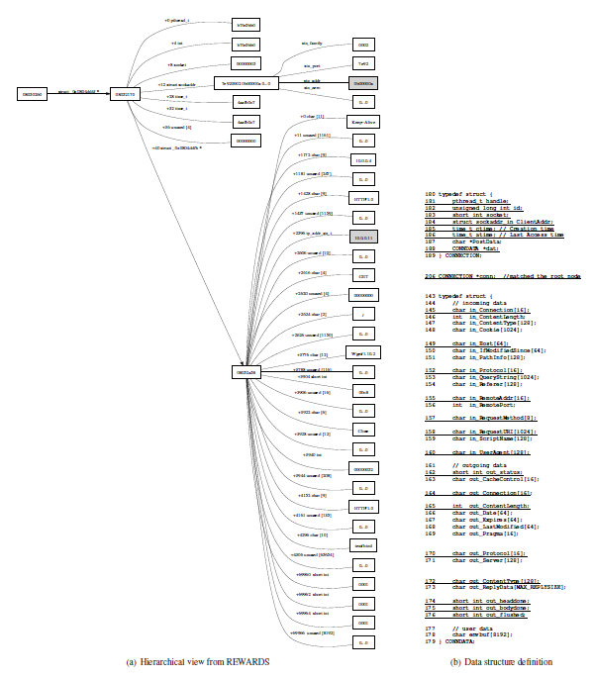

Slide 37
Limitations
Coverage
Few system calls and libc calls can lead to worse results

