Slide 1
Malware Analysis
CS-695 Host Forensics
Georgios Portokalidis

Slide 2
Why?
To access damage
To identify infection signs for discovering other compromised hosts
To determine how it can be removed
To generate a “vaccine” for the infection
To learn

Slide 3
So What Can You Do with A Malware Sample?
Statically analyze it
  Disassemble
  Extract
    Function call graph
    Control flow graph
    Invoked APIs
  Generate a fingerprint
  What is the problem with these?
Problems associated with static analysis
Disassembly is difficult
Self-modifying code
Little information

Slide 4
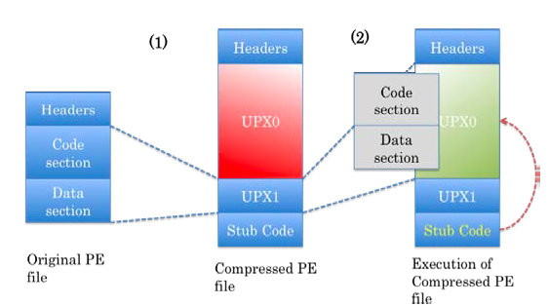
Polymorphism
Compression (packers)
  Smaller binaries → smaller footprint
Examples: UPX, Aspack, FSG, PE Compact, …

Slide 5
Polymorphism II
Encryption
  Packing with a key
  Obfuscate string, functions, parts of the code
  XOR-based
  More advanced
    Examples: Morphine, Daemon, telock, Yoda’s Crypter
  Where is the key?

Slide 6
Defeating Polymorphism
Known packers/encypters can be identified
How?
Stub code cannot be hidden

Slide 7
Defeating Polymorphism
What about …
  unknown packers?
  Metamorphism?
  inability to locate encryption key?
Execute the malware
  Use a debugger to step execution
    IDA, OllyDbg
  Dump process memory

Slide 8

Before Diving In

Slide 9

Prepare Your Environment
Properties
  Quickly restore clean state
    Fast rollback mechanism
  Isolate malware
    Try not to become a victim
  Monitor malware operation
    That’s why we are doing this

Slide 10


Using a Virtual Machine
Features
  Quick restore to previous states
  Isolation from host system
Risks:
  Malware can hide its functionality
    The VM can be detected
  Malware can breakout
    VM software can have bugs
    Worms can attack services running on the host

Slide 11

What About Networking?
Should the VM or host be able to contact the Internet?

Slide 12

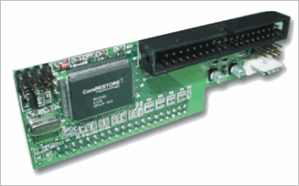
Without a VM
You need a way to quickly restore a physical machine to a pristine state
Commercial solutions
    Norton Ghost
    CoreRESTORE from CorePROTECT
Free
  Udpcast (free)
  Truman (free)
What is the problem with these?

Slide 13

Detecting the Matrix VM
Malware can
  Hide or alter its functionality
  Attempt to breakout
How?
  Look for VM artifacts in processes, file system, and/or registry
    Special files and processes (e.g., VMtools)
  Look for VM artifacts in memory
    How do you peak into memory?
  Look for VM-specific virtual hardware
    Device names, device parameters (e.g., MAC address)
  Look for VM-specific processor instructions and capabilities
    Extra instructions added by VM for guest-host communication
    VMs frequently don’t support obscure instructions or have limited support for instructions
    `The red pill’
  Remotely by inspecting IP packets

Slide 14

Detecting VMs with the Red Pill
Proposed by Joanna Rutkowska
Runs a single instruction
  SIDT → Store Interrupt Descriptor Table
    Store IDT in memory
Facts and observations
  On VMware guest machines, the IDT is typically located at 0xffXXXXXX
  On VirtualPC guests, it is located at 0xe8XXXXXX
  On host operating systems, it is located lower than that, typically around 0x80ffffff (Windows) and 0xc0ffffff (Linux)
It is sufficient to look at the first byte of the address
  If it’s greater than 0xd0, you've got a virtual machine
  If it is less than or equal to 0xd0, you are in a real machine

Slide 15
Red Pill++
Other OS features can be obtained with other instructions
  The Global Descriptor Table (GDT), measured by the SGDT instruction
  The Local Descriptor Table (LDT), measured by the SLDT instruction
Scoopy VM detection toolkit

Slide 16
Anti-Debugging
Malware has more weapons in its arsenal to resist analysis
  Windows: IsDebuggerPresent()
  Linux: ptrace()

Slide 17
A Study of the Packer Problem and Its Solutions (RAID 2008)
Fanglu Guo, Peter Ferrie, Tzi-cker Chiueh
Symantec Research Laboratories

Slide 19
Identifying Dormant Functionality in Malware Programs (S&P 2010)
Paolo Milani Comparetti, Guido Salvaneschi, Engin Kirda, Clemens Kolbitsch, Christopher Kruegel and Stefano Zanero

Slide 20
The Problem
Packers make static analysis hard or impossible
Current state of the art executes malware in a protected environment
  Examples: Anubis, CWSandbox
What are the problems with dynamic analysis?
  Does not observe all execution paths
  Malware can misdirect
    Detect VM, trigger conditions

Slide 21
Examples
Paths not followed
Missing paths
if (InVM()) {
// Benign functionality
} else {
// Malicious functionality
}
void (*fptr)(void);
…
fptr();
?
?
?

Slide 22
Explore More Paths
Find inputs that can cause malware to run down different execution paths
  Symbolic execution
Force execution down the other path
Can be successful for the previous example, but …
  Missing paths due to indirect control flow transfers remain an unsolved problem
  We face the path explosion problem
    Exponential growth of paths that need to be explored

Slide 23
The Big Idea
Code blocks
performing
Particular
tasks
Downloaded
malware
Update registry
Dynamic
analysis
Disable antivirus
Install kernel hook
Unpack
Model code blocks
Model

Slide 24
The Big Idea
Downloaded
malware B
Identify code blocks
Update registry
Disable antivirus
Model
Dynamic
analysis
Unpack
Install kernel hook
Covered by dynamic analysis

Slide 25
Defining Behavior
What exposes program behavior?
  API and system calls
  Relationships between them
connect(sd, ip:25)
sd = socket()
sd = socket()
send(sd, buf, len)
sd = socket()
connect(sd, ip:port)
send(sd, buf, len)
connect(sd, ip:port)
send(sd, buf, len)

Slide 26
Defining Behavior
What exposes program behavior?
  API and system calls
  Relationships between them
Use data tracking to link calls
connect(sd, ip:25)
sd = socket()
sd = socket()
send(sd, buf, len)
sd = socket()
connect(sd, ip:port)
send(sd, buf, len)
connect(sd, ip:port)
send(sd, buf, len)

Slide 27
Defining Behavior
What exposes program behavior?
  API and system calls
  Relationships between them
Use data tracking to link calls
Link runtime calls with code regions
Extend code
segment or genotype
sd = socket()
connect(sd, ip:25)
send(sd, buf, len)

Slide 28
Refining Genotypes
Extracted code segments may include instructions that are not related with a particular behavior
  General purpose utility functions (e.g., string processing)
  Instructions from other code segments
Filtering
  Whitelisting common instruction patterns
  Filtering instructions that do not operate on data related with a behavior
    This instructions will always behave the same independently from the outcome of calls
More details on the paper…

Slide 29
Frequently Encountered Behaviors
Spam
Port scan
Packet sniffing
Key logger
Kill process (typically anti-virus process)
Backdoor (listening socket)
Packet flood (DoS)
Download binary and execute

Slide 30
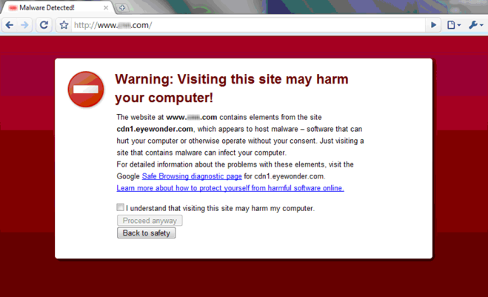
Additional Reading
Malware analysis is a very active field
  Plenty of Anubis related papers
    http://anubis.iseclab.org/
Sophisticated malware still requires manual analysis
  E.g., Stuxnet
Malware analysis has led to safer browsing
Scalability issues

