Slide 1
Hiding Malware
Rootkits
CS-695 Host Forensics
Georgios Portokalidis

Slide 2
Why Hide?
The longer you stay undetected
  Avoid:
    Removal
    Analysis (How it works?)
    Blame (Who Dunnit?)

Slide 3

How Would you Hide?
Deception
  Present a fake image of how things are
How do we examine the system?
  We’ve seen some tools earlier in this course
Possibilities
  Modify programs to lie
  Modify the kernel to lie
  Modify VM to lie
  Modify the HW to lie?

Slide 4
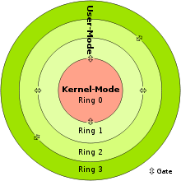
Rootkits
Malicious software designed to hide malware related data
  Files
  Processes
  Logins
  Network connections
The inner the level controlled, the better!
Because…
Hypervisor-level rootkits
Bootkits
Firmware-level bootkits
Kernel-level rootkits
User-level rootkits

Slide 5
User-level Rootkits
Modify
  Utilities → ps, netstat, top, sshd
  API hooks → replace system calls, etc.
  Applications → Alter behavior (e.g., modify Windows Explorer to hide a file)

Slide 6
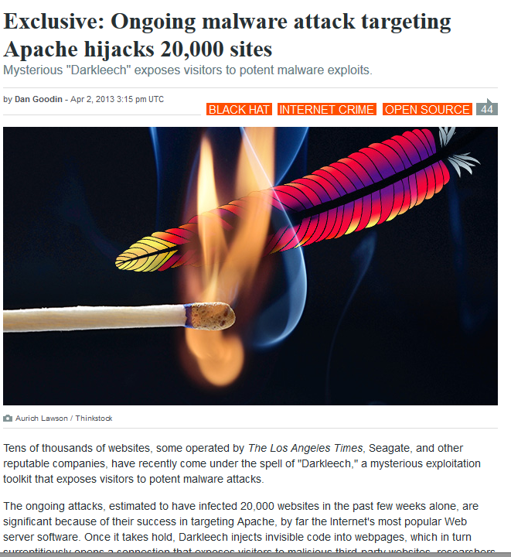

Slide 7
Kernel-level Rootkits
Mostly implemented as Loadable Kernel Modules
Modify or add
  Kernel code (Phantasmagoria adds instructions in system calls)
  Kernel data structures (remove malware from process lists, FU)
  APIs (Knark adds entries in the proc file system, SuckIT adds new system calls)

Slide 8
Hypervisor Rootkits
Runs with higher privilege than the kernel
Developed in academia
  SubVirt paper
  Blue pill
Rootkit
Applications
Ring 3
Unused
Rings 1 and 2
Kernel
Ring 0
Ring -1 (Intel VT-x AMD-V)
Reserved for hypervisor
Rootkit

Slide 9
Firmware-level Rootkits
Firmware is the lowest-level of software that controls certain operations of hardware
Till recently the integrity of firmware was not checked
  Companies have only recently started using signed firmware updates
Examples:
  Organized crime tampers with European card swipe device http://www.theregister.co.uk/2008/10/10/organized_crime_doctors_chip_and_pin_machines
  Attacks on BIOS anti-theft devices turn them into rootkits http://www.blackhat.com/presentations/bh-usa-09/ORTEGA/BHUSA09-Ortega-DeactivateRootkit-PAPER.pdf

Slide 10
Defenses
Check for file integrity → Tripwire, chkrootkit
Check for divergent results → checkps
Protecting hooks → system calls, internal kernel APIs
Code integrity checks → page-level signing

Slide 11
File Integrity Testing
Example
  Create MD5s of binaries on the system
  Periodically check installed binaries vs stored MD5s
Challenges?
  Storing the MD5s out of reach
  Keeping up with updates
  Storing the tools out of reach!
Limitations?
  In-memory modifications
  Lower-level rootkits

Slide 12
Looking for Divergent Results
Example
  Run binaries and collect results
    ps, top, netcat
  Collect results from other sources
    Directly access /proc filesystem
  Compare results to find discrepancies
Challenges?
  Find other sources of information
  False alerts, system state is dynamic
  Storing the tools out of reach!
Limitations?
  In-memory modifications
  Lower-level rootkits
  Frequently rootkit specific

Slide 13
Monitor API Hooks
Example
  Store currently used, good set of hooks
  Periodically read the values of hooks
  Compare values to identify hooks being replaced
Challenges?
  Which APIs should be monitored
  False alerts, hooks can be placed for legitimate reasons
    That’s usually the problem with running multiple antivirus engines on your PC
  Storing the tools out of reach!
Limitations?
  Cannot detect changes in …
    Kernel code
    Kernel data structures besides APIs
  Lower-level rootkits

Slide 14
Code-integrity Checking
Example
  Upon loading a page of code hash its contents
  Periodically re-hash every page and check it against previously taken hash
Can be done
  By the kernel
  A hypervisor
  A coprocessor
Challenges
  Storing the hashes out of reach
  Keeping up with code updates
  Code provenance
Limitations
  Pages containing both code and data
  Lower-level rootkits

Slide 15
Countering Kernel Rootkits with Lightweight Hook Protection

Slide 16
Protecting Kernel Hooks
What are hooks?
  Function callbacks that are dynamically set and called when certain conditions occur E.g., event_callback(void *ptr)
  The system call table contains hooks
Hooks can be distributed around the kernel
  Example: Heap allocated structures containing callbacks
  struct io_struct { callback_t readf, writef}

Slide 17
Protecting Kernel Hooks
Rootkits can modify hooks to receive control of certain events
How can we protect these hooks from being overwritten?
  Make them read only for the kernel
    We need to find them first!
  This is what this paper proposes
    Why is this possible?

Slide 18
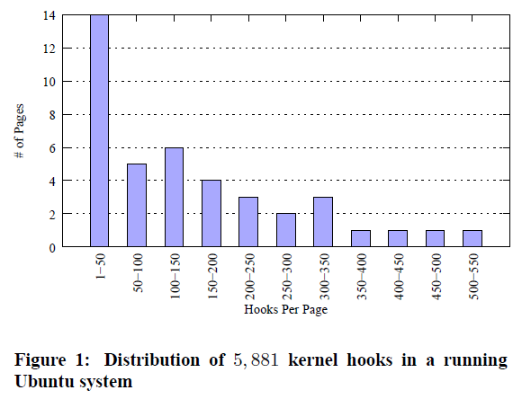
Find the Hooks

Slide 19
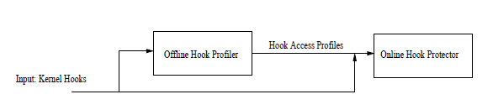
Find the Hooks
We need to find
  The function pointers
  The instruction accessing them
Accomplished through a combination of static and dynamic analysis
  Analyze source code statically
  Execute the kernel in an emulator (QEMU)

Slide 20
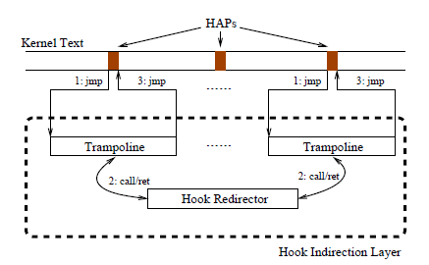
Protect the Hooks
Move hooks to memory protected area
  The can no longer be overwritten arbitrarily
Control how they are used by legitimate code
  Hook indirection

Slide 21
SecVisor: A Tiny Hypervisor to Provide Lifetime Kernel Code Integrity for Commodity OSes

Slide 22
SecVisor
Goal: Ensure code integrity even if kernel has been compromised
  Code can be injected but not executed
Why tiny?
  Smaller attack surface
  Less changes required for adoption
  Faster

Slide 23
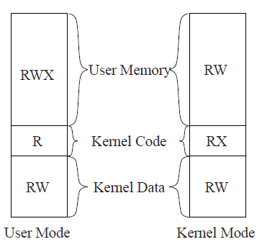
Virtualized Page Tables
Hypervisor page tables enforce stricter memory permissions
  Shadow page tables!
  Nested page tables!
Intercept boundary crosses to update protections
How can we load new code?
Target memory protection

Slide 24
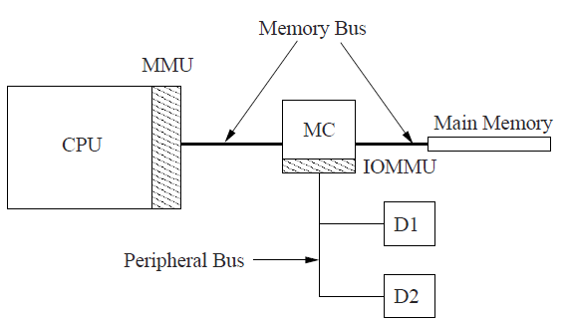
What About?
Loadable kernel modules
  Loading goes through SecVisor
    Requires symbol relocation support
Hardware devices that can write to memory
  DMA

Slide 25
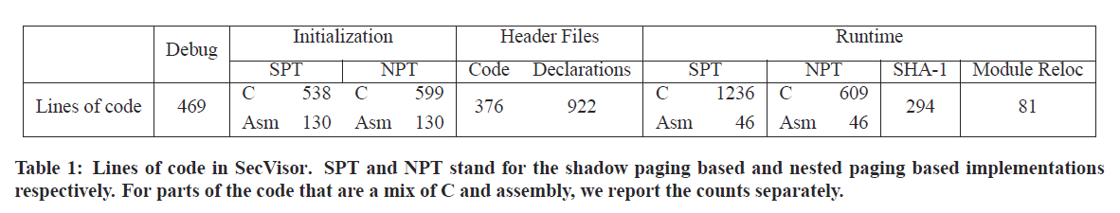
How Tiny?
Limitations
  Only single CPU systems supported
  Self-modifying code
  Code provenance

Slide 26
SubVirt: Implementing malware with virtual machines

Slide 27
Rootkits as VMs
VM 1
VM 2
VM n
Process
Process
Process
Process
Process
Process
Process
Process
Process
…
…
…
…
Kernel
Kernel
Kernel
Hypervisor
Hardware
Regular Virtualization Configuration

Slide 28
Rootkits as VMs
Process
Process
Process
…
Kernel
Hypervisor
Hardware
On most PCs

Slide 29
Rootkits as VMs
VM 1
Process
Process
Process
…
Undetectable
Kernel
Rootkit
Hardware
With a Hypervisor Rootkit

Slide 30
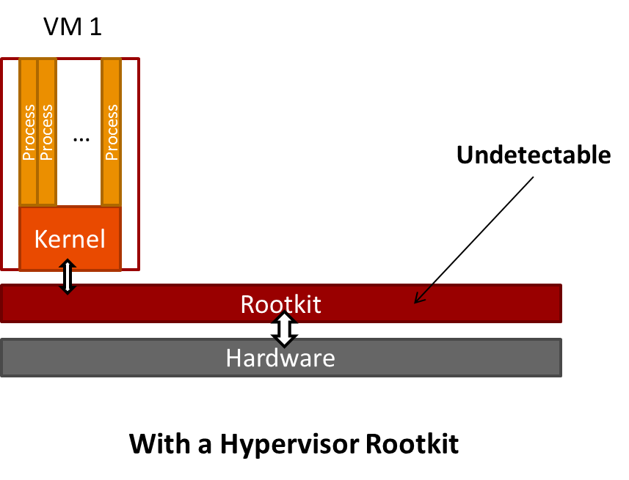
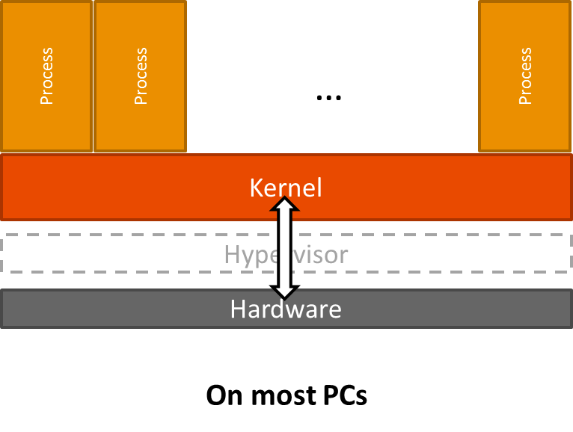
How Is It Done?

Slide 31
How Is It Done?
Antiviruses scan for this
Getting the rootkit to run
  Store to disk
  Modify boot sequence to execute rootkit
    Only do it at the last possible moment
      Could this be bypassed?
  Reboot

Slide 32
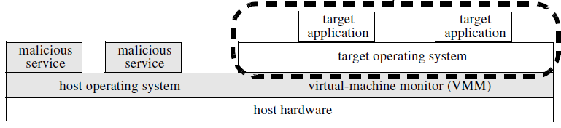
How Is It Done?
Install malicious services
  Why?
    Control the rootkit
    Modify the user (target) operating system

Slide 33
Removing Such Rootkits?
Be a level lower
Boot from alternative medium
How about just detecting?

Slide 34
Return-Oriented Rootkits: Bypassing Kernel Code Integrity Protection Mechanisms

Slide 35
Return-Oriented Programming
Stack
Code
Actions
0xb8800000
0x00000001
0xb8800010
0x00000002
0xb8800020
0xb8800010
0x00400000
0xb8800030
0xb8800000:
pop eax
ret
...
0xb8800010:
pop ebx
ret
...
0xb8800020:
add eax, ebx
ret
...
0xb8800030:
mov [ebx], eax
ret
esp
eax = 1
ebx = 2
eax += ebx
ebx = 0x400000
*ebx = eax

Slide 36
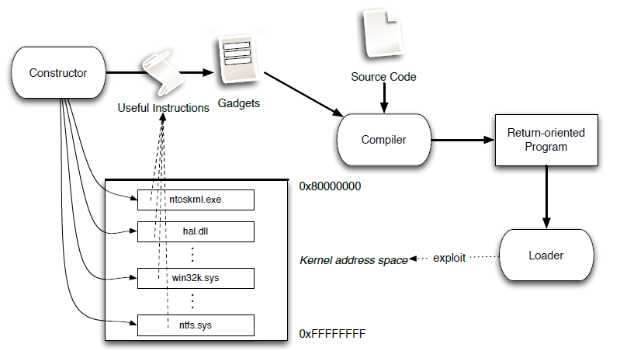
ROP-based Rootkits as Easy as Compiling

