Slide 1
Relating to the Network
CS-695 Host Forensics
Georgios Portokalidis

Slide 2


Slide 3
Today’s Lecture
Connecting the dots between a host and the network
  Connect
    Suspicious evidence on the host with network activity
    Suspicious network activity with evidence on the host
Understanding the communication protocol of unknown software
Fine-grain data tracking

Slide 4
The Big Picture
What are the phases of an intrusion?
  Reconnaissance
    Scanning, probing
  Exploitation
    Compromise, gain initial control
  Reinforcement
    Bring in tools, rootkits, etc.
  Consolidation
    Cleanup, install backdoor
  Pillage
    Steal data, etc.

Slide 5






Connecting the Dots
What tools come into mind for collecting network information?
WIRESHARK
BRO
netstat
lsof
Netflow
Audit Record Generation and Utilization System

Slide 6
netstat and lsof
An easy way to retrieve active or listening sockets and the processes using them
How would you run netstat?
  netstat –an
    (-a) Display all connections
    (-n) Use numeric port numbers
How would you collect and preserve the data?
  netstat –an > netstat.log
  md5sum –b netstat.log > netstat.md5
  scp –r netstat.* user@analysis.host:.
analysis.host$ nc –v –l –p 10000 > nestat.log
victim$ netstat –an | nc analysis.host 10000
analysis.host$ nc –v –l –p 10000 > nestat.log
victim$ ssh –L10000:analysis.host:10000 –N user@analysis.host
victim$ netstat –an | nc localhost 10000

Slide 7
Active Connections
tcp 0 2 127.0.0.1:23 102.60.21.3:1820 ESTABLISHED
tcp 0 0 102.60.21.3:1820 127.0.0.1:23 ESTABLISHED
tcp 0 2 102.60.21.3:2323 94.178.4.82:3502 ESTABLISHED
tcp 0 0 102.60.21.3:2323 0.0.0.0:* LISTEN
tcp 0 0 102.60.21.3:22 94.90.84.93:2094 ESTABLISHED
tcp 0 0 102.60.21.3:3879 94.90.84.93:2090 ESTABLISHED
tcp 0 0 0.0.0.0:3879 0.0.0.0:* LISTEN
tcp 1 0 102.60.21.3:515 94.90.84.93:1761 CLOSE_WAIT
tcp 0 0 102.60.21.3:23 102.60.21.178:54495 ESTABLISHED
tcp 0 0 0.0.0.0:80 0.0.0.0:* LISTEN
tcp 0 0 0.0.0.0:443 0.0.0.0:* LISTEN
tcp 0 0 0.0.0.0:587 0.0.0.0:* LISTEN
.....
udp 0 0 0.0.0.0:1025 0.0.0.0:*
udp 0 0 0.0.0.0:990 0.0.0.0:*
udp 0 0 0.0.0.0:1024 0.0.0.0:*
udp 0 0 0.0.0.0:111 0.0.0.0:*

Slide 8
Listening Ports
tcp 0 2 127.0.0.1:23 102.60.21.3:1820 ESTABLISHED
tcp 0 0 102.60.21.3:1820 127.0.0.1:23 ESTABLISHED
tcp 0 2 102.60.21.3:2323 94.178.4.82:3502 ESTABLISHED
tcp 0 0 102.60.21.3:2323 0.0.0.0:* LISTEN
tcp 0 0 102.60.21.3:22 94.90.84.93:2094 ESTABLISHED
tcp 0 0 102.60.21.3:3879 94.90.84.93:2090 ESTABLISHED
tcp 0 0 0.0.0.0:3879 0.0.0.0:* LISTEN
tcp 1 0 102.60.21.3:515 94.90.84.93:1761 CLOSE_WAIT
tcp 0 0 102.60.21.3:23 102.60.21.178:54495 ESTABLISHED
tcp 0 0 0.0.0.0:80 0.0.0.0:* LISTEN
tcp 0 0 0.0.0.0:443 0.0.0.0:* LISTEN
tcp 0 0 0.0.0.0:587 0.0.0.0:* LISTEN
.....
udp 0 0 0.0.0.0:1025 0.0.0.0:*
udp 0 0 0.0.0.0:990 0.0.0.0:*
udp 0 0 0.0.0.0:1024 0.0.0.0:*
udp 0 0 0.0.0.0:111 0.0.0.0:*

Slide 9
Processes Corresponding to Connections
netstat –anp
Proto Recv-Q Send-Q Local Address Foreign Address State
tcp 0 0 0.0.0.0:17500 0.0.0.0:* LISTEN 3760/dropbox
Lsof
  Prints all open descriptors!
COMMAND PID USER FD TYPE DEVICE SIZE/OFF NODE NAME
thunderbi 2349 user 44u IPv4 16988 0t0 TCP 0.0.0.0:39607->155.246.14.12:imap2 (ESTABLISHED)

Slide 10
Routing Table
netstat –rn
Destination Gateway Genmask Flags MSS Window irtt Iface
0.0.0.0 155.246.81.1 0.0.0.0 UG 0 0 0 eth0
155.246.81.0 0.0.0.0 255.255.255.0 U 0 0 0 eth0
169.254.0.0 0.0.0.0 255.255.0.0 U 0 0 0 eth0
172.16.92.0 0.0.0.0 255.255.255.0 U 0 0 0 vmnet8
192.168.15.0 0.0.0.0 255.255.255.0 U 0 0 0 vmnet1
Why would someone modify the routing table?
  Redirect traffic to avoid a firewall, IDS, etc.

Slide 11
More Data…
What about historical data?
  Data collecting software needs to be running
    Locally -> Unsafe
    At a router, switch, etc.
Type of data that can be collected
  Full content data
  Session data
  Alert data
  Statistical data
What is more likely to be found installed in most networks?

Slide 12
Full Content Data
SSH-2.0-OpenSSH_5.9p1 Debian-5ubuntu1
SSH-2.0-OpenSSH_6.1
............%..\.n7.5.....ecdh-sha2-nistp256,ecdh-sha2-nistp384,ecdh-sha2-nistp521,diffie-hellman-group-exchange-sha256,diffie-hellman-group-exchange-sha1,diffie-hellman-group14-sha1,diffie-hellman-group1-sha1...#ssh-rsa,ssh-dss,ecdsa-sha2-nistp256....aes128-ctr,aes192-ctr,aes256-ctr,arcfour256,arcfour128,aes128-cbc,3des-cbc,blowfish-cbc,cast128-cbc,aes192-cbc,aes256-cbc,arcfour,rijndael-cbc@lysator.liu.se....aes128-ctr,aes192-ctr,aes256-ctr,arcfour256,arcfour128,aes128-cbc,3des-cbc,blowfish-cbc,cast128-cbc,aes192-cbc,aes256-cbc,arcfour,rijndael-cbc@lysator.liu.se....hmac-md5,hmac-sha1,umac-64@openssh.com,hmac-sha2-256,hmac-sha2-256-96,hmac-sha2-512,hmac-sha2-512-96,hmac-ripemd160,hmac-ripemd160@openssh.com,hmac-sha1-96,hmac-md5-96....hmac-md5,hmac-sha1,umac-64@openssh.com,hmac-sha2-256,hmac-sha2-256-96,hmac-sha2-512,hmac-sha2-512-96,hmac-ripemd160,hmac-ripemd160@openssh.com,hmac-sha1-96,hmac-md5-96....none,zlib@openssh.com....none,zlib@openssh.com....................................../..5......ecdh-sha2-nistp256,ecdh-sha2-nistp384,ecdh-sha2-nistp521,diffie-hellman-group-exchange-sha256,diffie-hellman-group-exchange-sha1,diffie-hellman-group14-sha1,diffie-hellman-group1-sha1...:ecdsa-sha2-nistp256-cert-v01@openssh.com,ecdsa-sha2-nistp384-cert-v01@openssh.com,ecdsa-sha2-nistp521-cert-v01@openssh.com,ecdsa-sha2-nistp256,ecdsa-sha2-nistp384,ecdsa-sha2-nistp521,ssh-rsa-cert-v01@openssh.com,ssh-dss-cert-v01@openssh.com,ssh-rsa-cert-v00@openssh.com,ssh-dss-cert-v00@openssh.com,ssh-rsa,ssh-dss....aes128-ctr,aes192-ctr,aes256-ctr,arcfour256,arcfour128,aes128-cbc,3des-cbc,blowfish-cbc,cast128-cbc,aes192-cbc,aes256-cbc,arcfour,rijndael-cbc@lysator.liu.se....aes128-ctr,aes192-ctr,aes256-ctr,arcfour256,arcfour128,aes128-cbc,3des-cbc,blowfish-cbc,cast128-cbc,aes192-cbc,aes256-cbc,arcfour,rijndael-cbc@lysator.liu.se....hmac-md5,hmac-sha1,umac-64@openssh.com,hmac-sha2-256,hmac-sha2-512,hmac-ripemd160,hmac-ripemd160@openssh.com,hmac-sha1-96,hmac-md5-96....hmac-md5,hmac-sha1,umac-64@openssh.com,hmac-sha2-256,hmac-sha2-512,hmac-ripemd160,hmac-ripemd160@openssh.com,hmac-sha1-96,hmac-md5-96....none,zlib@openssh.com,zlib....none,zlib@openssh.com,zlib....................L.....A.n.v....T8.!f.....L......R..0..|....H.G..8.c.........;......y............$
....h....ecdsa-sha2
Log entire packets
Challenges
  Slowing down the network
  Rapidly growing storage requirements
  What about encryption?
WIRESHARK

Slide 13
TCP Session Data
Cheap to store
Sometimes it’s enough to know who talked
Address A Port A Address B Port B Packets Bytes
10.0.1.3 64793 x.x.x.125 5222 52 22210
10.0.1.3 64794 x.x.x.85 443 55 17582
…
10.0.1.3 65338 x.x.x.5 443 16 1145
Statistical
(e.g., tcptrace)
Netflow
Audit Record Generation and Utilization System

Slide 14
Alert Data
Intrusion detection systems generate alerts for “interesting” data
  Snort
  Bro
BRO
[**] [1:718:6] TELNET login incorrect [**]
[Classification: Potentially Bad Traffic] [Priority: 2]
09/08-15:40:18.391368 94.200.10.71:23 -> 102.60.21.3:1552
TCP TTL:63 TOS:0x10 ID:6313 IpLen:20 DgmLen:85 DF
***AP*** Seq: 0x38DB3A4 Ack: 0x6A4825DA Win: 0x8218 TcpLen: 32
TCP Options (3) => NOP NOP TS: 460280 739040
[Xref => http://www.whitehats.com/info/IDS127]
[**] [1:498:3] ATTACK RESPONSES id check returned root [**]
[Classification: Potentially Bad Traffic] [Priority: 2]
09/08-16:11:05.410761 102.60.21.3:2323 -> 94.178.4.82:3502
TCP TTL:64 TOS:0x0 ID:24781 IpLen:20 DgmLen:108 DF
***AP*** Seq: 0xDBC0D386 Ack: 0x22CA5EEE Win: 0x7FF8 TcpLen: 20
alert tcp any any -> 10.1.1.0/24 80 (content: "/cgi-bin/phf"; msg: "PHF probe!";)
alert tcp any any -> 10.1.1.0/24 6000:6010 (msg: "X traffic";)
alert tcp !10.1.1.0/24 any -> 10.1.1.0/24 6000:6010 (msg: "X traffic";)

Slide 15
Reverse engineering communication protocols

Slide 16
Related Work
W. Cui, J. Kannan, and H. J. Wang
Discoverer: Automatic Protocol Reverse Engineering from Network Traces
Usenix Security 2007
Juan Caballero, Heng Yin, Zhenkai Liang, and Dawn Song
Polyglot: Automatic extraction of protocol format using dynamic binary analysis
CCS 2007
Z. Lin, X. Jiang, D. Xu, and X. Zhang
Automatic protocol format reverse engineering through context-aware monitored execution
NDSS 2008

Slide 17
Usefulness
What can you do with knowing a protocol?
  Generate signatures for NIDS (Snort, Bro, etc.)
  Fuzz testing
  Block traffic (communications with botnet C&C center)
Why automatic?
  Tedious process
  Hard problem
  Time consuming

Slide 18
Two Different Approaches
Just looking at network data
  Statistical methodologies and machine learning is used to identify structure
Looking at what the host does with the data
  Observe how a program uses network data
    Similar to data structure reverse engineering
Limitations:
  Encryption

Slide 19
Challenges
Large number of fields
Varying size protocol fields
Complex relationships between fields
Encapsulated protocols

Slide 20
AutoFormat
AutoFormat is based on the key observation that different protocol fields in the same message are typically handled in different execution contexts such as the run-time call stack and location of the instruction being executed
Adjacent message bytes belonging to the same protocol are usually handled in the same execution context

Slide 21
Example: HTTP parsing
119 int read_header(int sid) {
...
137 if (sscanf(line, "%[^ ] %[^ ] %[^ ]", conn[sid].dat->in_RequestMethod,
conn[sid].dat->in_RequestURI, conn[sid].dat->in_Protocol)!=3)
...
147 while (strlen(line)>0) {
...
154 if (strncasecmp(line, "Cookie: ", 8)==0)
strncpy(conn[sid].dat->in_Cookie, (char *)&line+8,
sizeof(conn[sid].dat->in_Cookie)-1);
156 if (strncasecmp(line, "Host: ", 6)==0)
157 strncpy(conn[sid].dat->in_Host, (char *)&line+6,
sizeof(conn[sid].dat->in_Host)-1);
...
160 if (strncasecmp(line, "User-Agent: ", 12)==0)
161 strncpy(conn[sid].dat->in_UserAgent, (char *)&line+12,
sizeof(conn[sid].dat->in_UserAgent)-1);
162 }
...
}

Slide 22
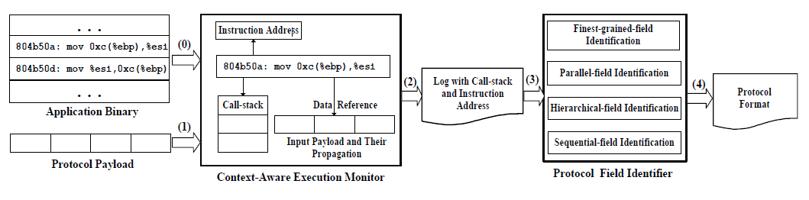
Design
Mark received data and keep track of propagation
Log when each byte is read (including execution context)
Process logs offline and generate a tree

Slide 23
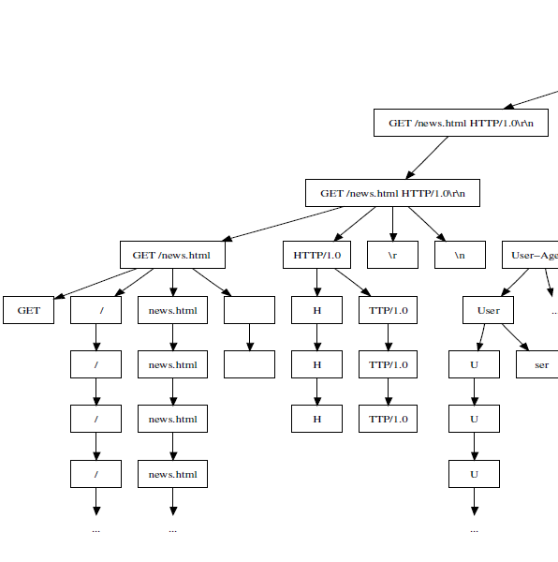

Slide 24
Refinement
Tokenization
  Text protocol have delimiters
  Merge two neighboring nodes if they form a single token
Redundant node deletion
  Delete notes with a single child
New node insertion
  Offsets of children may not much
  Add a new node with the data that was not referenced in the run

Slide 25
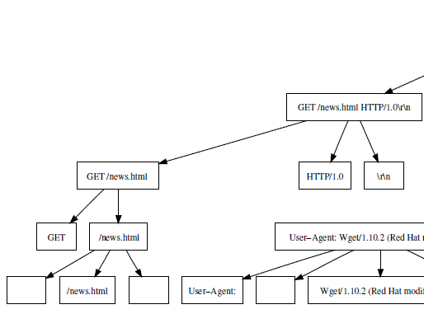
Refined Tree

Slide 26
Parallel and Sequential Fields
The position of parallel fields is exchangeable
  Usually processed in a loop
  Look for common “history” of execution contexts
When parallel fields are identified the rest are taken as sequential fields

Slide 27
Parallel and Sequential Fields
119 int read_header(int sid) {
...
137 if (sscanf(line, "%[^ ] %[^ ] %[^ ]", conn[sid].dat->in_RequestMethod,
conn[sid].dat->in_RequestURI, conn[sid].dat->in_Protocol)!=3)
...
147 while (strlen(line)>0) {
...
154 if (strncasecmp(line, "Cookie: ", 8)==0)
strncpy(conn[sid].dat->in_Cookie, (char *)&line+8,
sizeof(conn[sid].dat->in_Cookie)-1);
156 if (strncasecmp(line, "Host: ", 6)==0)
157 strncpy(conn[sid].dat->in_Host, (char *)&line+6,
sizeof(conn[sid].dat->in_Host)-1);
...
160 if (strncasecmp(line, "User-Agent: ", 12)==0)
161 strncpy(conn[sid].dat->in_UserAgent, (char *)&line+12,
sizeof(conn[sid].dat->in_UserAgent)-1);
162 }
...
}

Slide 28
Limitations
Limited to messages seen at a particular run
Byte granularity
Does not correlate multiple messages
Obfuscated binaries

Slide 29
Fine-grained tracking of network data

Slide 30

Argos Overview
Applications
Guest OS
Argos Emulator
Host OS
Notes:
Simpler, move bo earlier

Slide 31
Network Data Tracking
Tag network data as “tainted”
EAX
EBX
EBX
ECX
EDX
RAM
Port I/O

Slide 32
Network Data Tracking
Tag network data as “tainted”
Track “tainted” data propagation
  Arithmetic, logical operations
    ADD EBX, EAX
  Memory operations
    MOV EAX, [A]
EAX
EAX
EBX
ECX
EDX
RAM
A

Slide 33
Identifying Attacks
Check for tagged operands on
  Jumps
  Function calls
  Function returns
  System calls
EAX
EBX
ECX
EDX
RAM
JMP EAX
CALL EAX
RET
JMP A
INT 0x80

Slide 34
Example
Stack overflow
RET instruction
  EIP ← *(ESP)
  ESP← ESP + 4
1004
old PC
1003
old frame
1002
1001
1000
overflow
999
Buf
998
997
996
“space for X”
995
“space for Y”
994
993
992

Slide 35
What Does Is the Nature of the Tags
A
0x00000000
0x00000000
0x00000000
EAX
EBX
EAX
ECX
EDX
RAM
A
11111
000000000000000
000000000000000

Slide 36
Simple Signature Generation
Logged Network Flows
Argos Memory Log
New
Signature
Critical Exploit Bytes
(e.g. value loaded on EIP)
Similar
Signatures
Generalised
Signature

Slide 37
What If We Track Every Byte?
0x0000001
0x00000000
0x00000000
0x00000000
EAX
EBX
0
EAX
ECX
EDX
RAM
Network
data
A
0x00000001
0x00000002
0x00000003
0x00000004
Now we can detect which network data caused the overflow
000000000000000
000000000000000
1024

Slide 38
How About..
Multiple protocol fields ending up in the same buffer?
1004
old PC
1003
old frame
1002
1001
1000
999
Buf
998
Network data
997
996
“space for X”
995
“space for Y”
994
993
992

Slide 39
Better Attribution of Network Data Responsible for an Attack
Asia Slowinska and Herbert Bos
The Age of Data: pinpointing guilty bytes in polymorphic buffer overflows on heap or stack
ACSAC 2007
+ Creating better signatures for IDS

Slide 40
Vulnerability Signatures
Static length of the buffer: determine protocol fields which length cannot exceed a given limit
network
trace:
a protocol field
target
L
L₂ > L₁
vulnerable
buffer
L₁ = 8

Slide 41
How to Determine the Offending Bytes?
The easy case
memory
target
a protocol field
vulnerable
buffer
tainted data
untainted data

Slide 42
How to Determine the Offending Bytes?
Adjacent buffers
memory
target
a protocol field
vulnerable
buffer
void a_fun(char *net_buf){
char vuln_buf[8];
char a_buffer[8];
copy net_buf ➔ vuln_buf;
copy 8B of net_buf ➔ a_buf;
}
a_buffer
tainted data
untainted data
unrelated tainted data

Slide 43
How to Determine the Offending Bytes?
Gaps in tainted areas
target
unrelated
a protocol field
vulnerable
buffer
void a_fun(char *net_buf){
char unrelated[8];
char vuln_buf[8];
copy net_buf ➔ vuln_buf
copy 8 bytes of net_buf ➔ unrelated
}
tainted data
untainted data
unrelated tainted data

Slide 44
A Challenging Problem
We need more information
  Briefly, the age of the data in memory
Introducing…
  The AgeStamp: a global time counter, increased on
  each function call or return
    Whenever a tainted value is stored in memory, the current AgeStamp is associated with its address
    A history of function calls is stored for each
    process (stack address + AgeStamp)
      Same for the heap using malloc interposition

Slide 45
Tracking data across the network

Slide 46
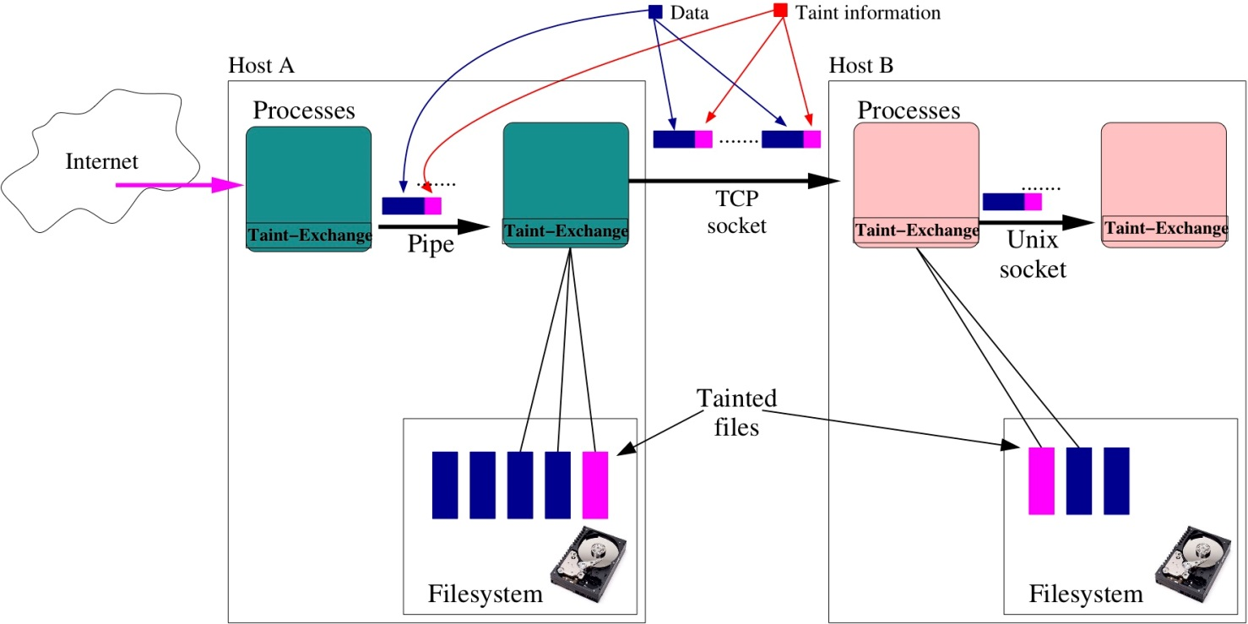
Exchanging Taint Information Over the Network
Fine-grained data tracking across processes

Slide 47
Data Encapsulation
Encapsulate data in and inject taint information
Challenge: space overhead
  Fixed overhead: bitmap, 1 bit per byte added
  Variable overhead: vector, per tainted data segment encoding

Slide 48
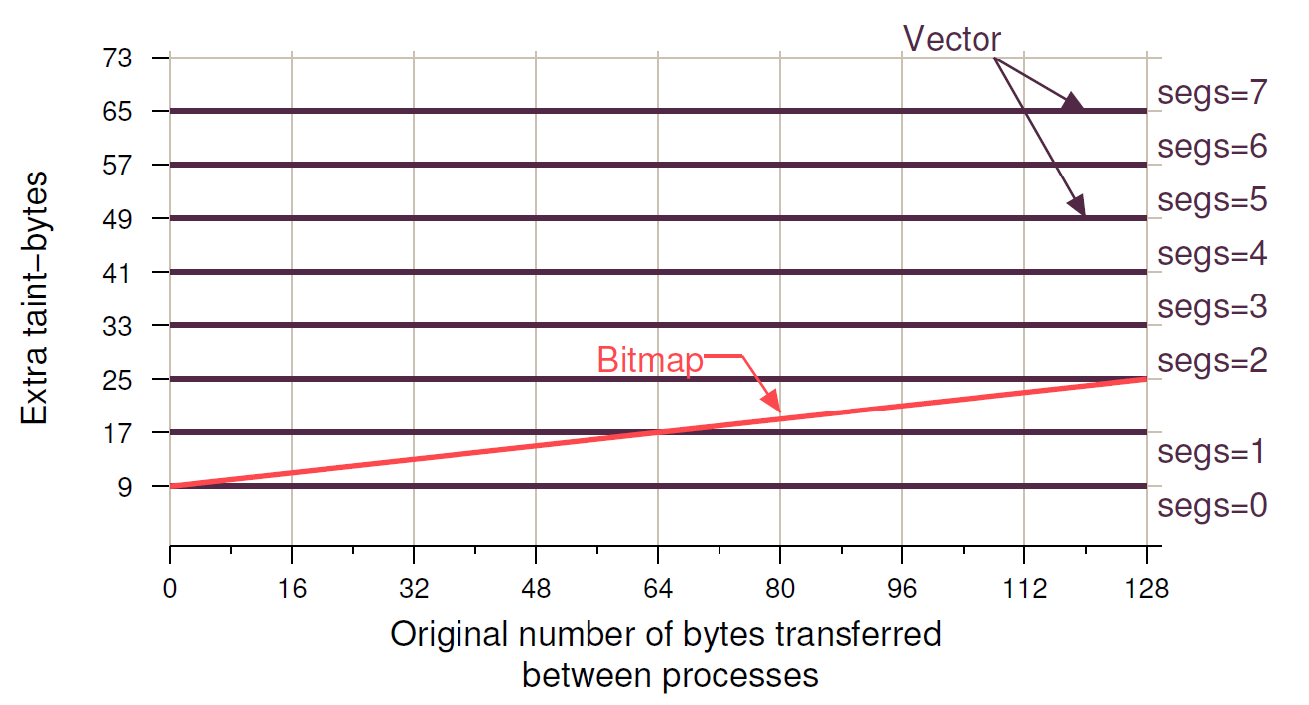
Selecting An Encoding Method

