Slide 1
Hiding Information, Encryption, and Bypasses
CS-695 Host Forensics
Georgios Portokalidis

Slide 2
Why Hide Information?
Preserve privacy
Data-loss prevention
Hide illegal activities/incriminating evidence
Protect confidential information
Protect trade secrets

Slide 3
How Would you Hide Information
Make it hard to find
  Hide among other information
Make it “unreadable”
  Encode information – use cryptography
All of the above
  Plausible deniability

Slide 4
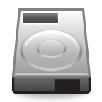
Different Types of Encryption
What other types can you think of?
/home
/usr
/etc
/encrypted_dir
/
/dev/sda1
/dev/sda2
Full disk
File/directory based

Slide 5
Different Types of Encryption
What other types can you think of?
/home
/usr
/etc
/encrypted_dir
/
Partition based
/dev/sda1
/dev/sda2
Full disk
File/directory based

Slide 6
Different Types of Encryption
What other types can you think of?
/home
/usr
/etc
/encrypted_dir
/
Partition based
Hiding in slack space
Example: with bmap
/dev/sda1
/dev/sda2
Full disk
File/directory based

Slide 7
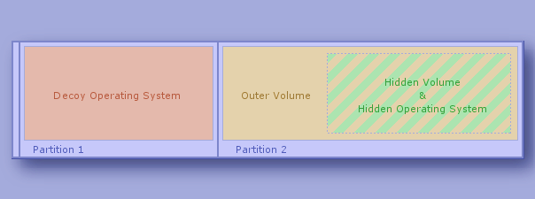
Decoy Operating Systems
TrueCrypt hidden partitions
Deniable encryption
  Many other tools

Slide 8
Other Data Hiding Locations
Store in “bad” data blocks
  The disk controller will hide this information

Slide 9
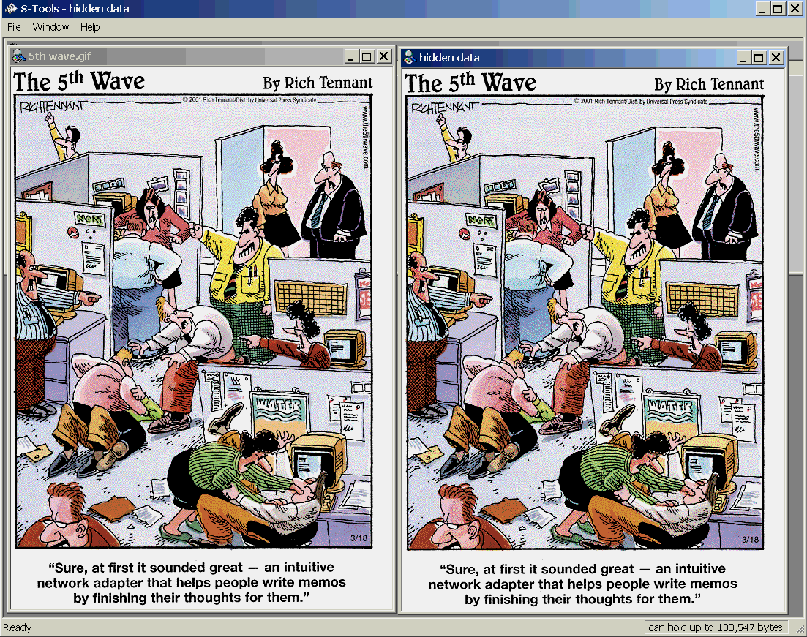
  Steganography
Hiding data within data
Very simple example
least significant bit (LSB) insertion
10010101 00001100 11001001
10010111 00001110 11001011
10011111 00010000 11001011

Slide 10
Security Analysis and Decryption of Lion Full Disk
Encryption

Slide 11
Overview
Apple introduced FileVault in Mac OS X Lion
Volume encryption support similar to existing systems
  E.g., TrueCrypt, PGP whole disk encryption, BitLocker
Volumes provide an abstraction that can group multiple partitions
Challenges:
  Closed system
    No documentation
    Closed source
Builds on CoreStorage volume manager
  Provides the extra layer needed to support the encryption

Slide 12
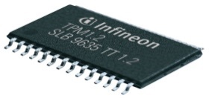
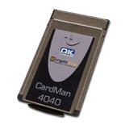
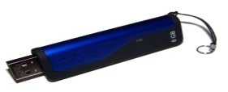
Issues
Where is the code that decrypts the volume?
How is the encryption key derived?
  Where is it stored?
How is encryption itself applied?
AES 128bits key = 22 characters
User password = n characters
Where is the rest 22 – n?
TPM
SmartCard
USB

Slide 13
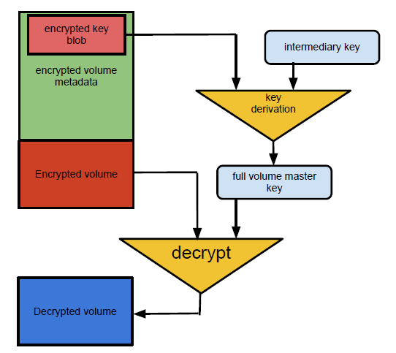
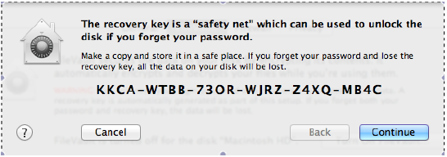
Key Derivation
More than one keys/passwords

Slide 14
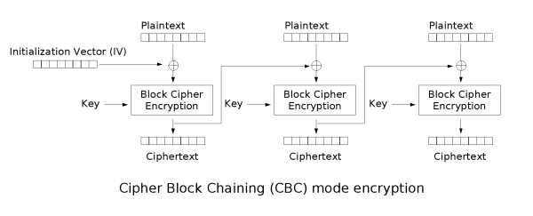
Encryption
Same data can result in the same ciphertext
  Solution: include block number in encryption
Bit flipping issues
  See paper
Disk block
AES blocks

Slide 15
Multiple Keys Must Decrypt the Master Key
Password
Recovery Key
Password
Recovery Key
Secondary Value 1
Secondary Value 2
Master Volume Key
Master Volume Key

Slide 16
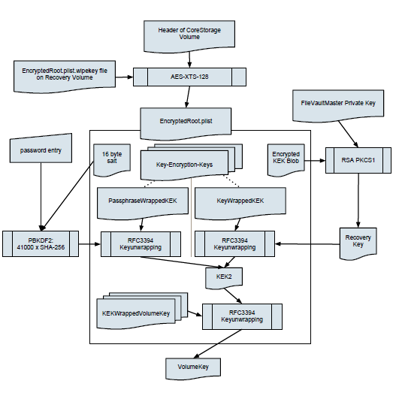

Slide 17
Attacking The Vault
Guessing the randomly generated keys

Slide 18
Pseudo Random Number Generators (PRNG)
Random numbers are generated based on a seed
  Full sequence of random numbers can be predicted if the seed is known
  PRNG state is preserved across boots
“Real” randomness or entropy is usually used to determine the seed
How much entropy does FileVault have ?

Slide 19
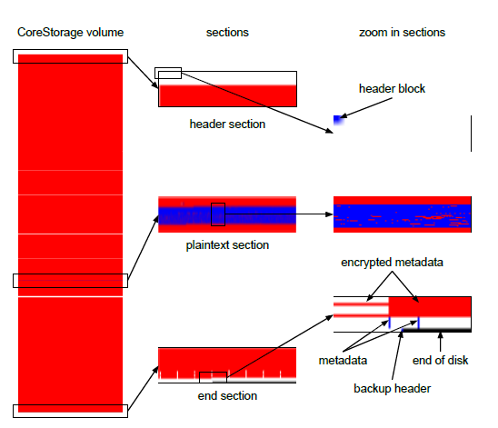
Attacking The Vault 2
Leftover unencrypted data
Unencrypted metadata can allow us to track the blocks that actually contain encrypted data
Unencrypted data can expose user data

Slide 20
Attacking The Vault 3
Attacking the user password
PBKDF2 generates a key based on salt and password
  Multiple hashing iterations ensure it’s hard to crack
    FileVault uses 41K iterations

Slide 21
Attacking The Vault 3
Brute forcing requires about 34 years
But…
  What if the user password is weak
    Example: 6 characters or a 4-digit pin
  About 6 hours
Known
41K iterations known

Slide 22
Improving FileVault
Secondary keys like the salt and key-encryption-keys need to be better guarded
  Or rely on user to enter long passwords
    Not likely to happen1
TPM systems can help there
  Keys can be stored safely in the TPM

Slide 23
Cold Boot Attacks
Cold Boot Attacks on Encryption Keys
  https://citp.princeton.edu/research/memory/media/
FROST: Forensic Recovery Of Scrambled Telephones
  https://www1.informatik.uni-erlangen.de/frost

